Slide 1
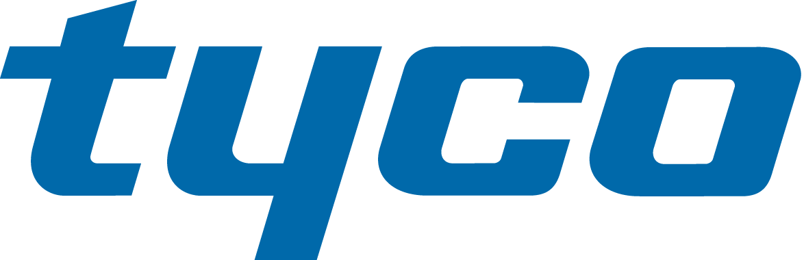
January 25, 2016
Johnson Controls and Tyco
Creating a Global Multi-Industrial Leader

Slide 2
NO OFFER OR SOLICITATION
This communication is not intended to and does not constitute an offer to sell or the solicitation of an offer to subscribe for or buy or an invitation to purchase or subscribe for any securities or the solicitation of any vote or approval in any jurisdiction, nor shall there be any sale, issuance or transfer of securities in any jurisdiction in contravention of applicable law.
ADDITIONAL INFORMATION AND WHERE TO FIND IT
In connection with the proposed transaction between Johnson Controls, Inc. (“Johnson Controls”) and Tyco International plc (“Tyco”), Tyco will file with the U.S. Securities and Exchange Commission (the “SEC”) a registration statement on Form S-4 that will include a joint proxy statement of Johnson Controls and Tyco that also constitutes a prospectus of Tyco (the “Joint Proxy Statement/Prospectus”). Johnson Controls and Tyco plan to mail to their respective shareholders the definitive Joint Proxy Statement/Prospectus in connection with the transaction. INVESTORS AND SECURITY HOLDERS OF Johnson Controls AND Tyco ARE URGED TO READ THE JOINT PROXY STATEMENT/PROSPECTUS AND OTHER RELEVANT DOCUMENTS FILED OR TO BE FILED WITH THE SEC CAREFULLY WHEN THEY BECOME AVAILABLE BECAUSE THEY WILL CONTAIN IMPORTANT INFORMATION ABOUT Johnson Controls, Tyco, THE TRANSACTION AND RELATED MATTERS. Investors and security holders will be able to obtain free copies of the Joint Proxy Statement/Prospectus (when available) and other documents filed with the SEC by Johnson Controls and Tyco through the website maintained by the SEC at www.sec.gov. In addition, investors and security holders will be able to obtain free copies of the documents filed with the SEC by Johnson Controls by contacting Johnson Controls Shareholder Services at Shareholder.Services@jci.com or by calling (800) 524-6220 and will be able to obtain free copies of the documents filed with the SEC by Tyco by contacting Tyco Investor Relations at Investorrelations@tyco.com or by calling (609) 720-4333.
PARTICIPANTS IN THE SOLICITATION
Johnson Controls, Tyco and certain of their respective directors, executive officers and employees may be considered participants in the solicitation of proxies in connection with the proposed transaction. Information regarding the persons who may, under the rules of the SEC, be deemed participants in the solicitation of the respective shareholders of Johnson Controls and Tyco in connection with the proposed transactions, including a description of their direct or indirect interests, by security holdings or otherwise, will be set forth in the Joint Proxy Statement/Prospectus when it is filed with the SEC. Information regarding Johnson Controls’ directors and executive officers is contained in Johnson Controls’ proxy statement for its 2016 annual meeting of shareholders, which was filed with the SEC on December 14, 2015. Information regarding Tyco’s directors and executive officers is contained in Tyco’s proxy statement for its 2016 annual meeting of shareholders, which was filed with the SEC on January 15, 2016.

Slide 3

Johnson Controls Cautionary Statement Regarding Forward-Looking Statements
There may be statements in this communication that are, or could be, “forward-looking statements” within the meaning of the Private Securities Litigation Reform Act of 1995 and, therefore, subject to risks and uncertainties, including, but not limited to, statements regarding Johnson Controls’ or the combined company’s future financial position, sales, costs, earnings, cash flows, other measures of results of operations, capital expenditures or debt levels are forward-looking statements. Words such as “may,” “will,” “expect,” “intend,” “estimate,” “anticipate,” “believe,” “should,” “forecast,” “project” or “plan” or terms of similar meaning are also generally intended to identify forward-looking statements. Johnson Controls cautions that these statements are subject to numerous important risks, uncertainties, assumptions and other factors, some of which are beyond Johnson Controls’ control, that could cause Johnson Controls’ or the combined company’s actual results to differ materially from those expressed or implied by such forward-looking statements, including, among others, risks related to: Johnson Controls’ and/or Tyco’s ability to obtain necessary regulatory approvals and shareholder approvals or to satisfy any of the other conditions to the transaction on a timely basis or at all, any delay or inability of the combined company to realize the expected benefits and synergies of the transaction, changes in tax laws, regulations, rates, policies or interpretations, the loss of key senior management, anticipated tax treatment of the combined company, the value of the Tyco shares to be issued in the transaction, significant transaction costs and/or unknown liabilities, potential litigation relating to the proposed transaction, the risk that disruptions from the proposed transaction will harm Johnson Controls’ business, competitive responses to the proposed transaction and general economic and business conditions that affect the combined company following the transaction. A detailed discussion of risks related to Johnson Controls’ business is included in the section entitled “Risk Factors” in Johnson Controls’ Annual Report on Form 10-K for the fiscal year ended September 30, 2015 filed with the SEC on November 18, 2015 and available at www.sec.gov and www.johnsoncontrols.com under the “Investors” tab. Any forward-looking statements in this communication are only made as of the date of this communication, unless otherwise specified, and, except as required by law, Johnson Controls assumes no obligation, and disclaims any obligation, to update such statements to reflect events or circumstances occurring after the date of this communication.
Tyco Cautionary Statement Regarding Forward-Looking Statements
This communication contains forward-looking statements within the meaning of the Private Securities Litigation Reform Act of 1995 including, but not limited to, Tyco’s expectations or predictions of future financial or business performance or conditions. Forward-looking statements are typically identified by words such as “believe,” “expect,” “anticipate,” “intend,” “target,” “estimate,” “continue,” “positions,” “plan,” “predict,” “project,” “forecast,” “guidance,” “goal,” “objective,” “prospects,” “possible” or “potential,” by future conditional verbs such as “assume,” “will,” “would,” “should,” “could” or “may”, or by variations of such words or by similar expressions. These forward-looking statements are subject to numerous assumptions, risks and uncertainties, which change over time. Forward-looking statements speak only as of the date they are made and we assume no duty to update forward-looking statements. Actual results may differ materially from current projections.

Slide 4
Forward-looking statements by their nature address matters that are, to different degrees, uncertain, such as statements about the consummation of the proposed transaction. Many factors could cause actual results to differ materially from these forward-looking statements, including, in addition to factors previously disclosed in Tyco’s reports filed with the SEC, which are available at www.sec.gov and www.tyco.com under the “Investor Relations” tab, and those identified elsewhere in this communication, risks relating to the completion of the proposed transaction on anticipated terms and timing, including obtaining shareholder and regulatory approvals, anticipated tax treatment, unforeseen liabilities, future capital expenditures, revenues, expenses, earnings, synergies, economic performance, indebtedness, financial condition, losses, future prospects, business and management strategies for the management, expansion and growth of the new combined company’s operations, the ability of Tyco and Johnson Controls to integrate their businesses successfully and to achieve anticipated synergies, changes in tax laws or interpretations, access to available financing, potential litigation relating to the proposed transaction, and the risk that disruptions from the proposed transaction will harm Tyco’s business.
Annualized, pro forma, projected and estimated numbers are used for illustrative purpose only, are not forecasts and may not reflect actual results.
Statement Required by the Irish Takeover Rules
The directors of Johnson Controls accept responsibility for the information contained in this communication other than that relating to Tyco and the Tyco group of companies and the directors of Tyco and members of their immediate families, related trusts and persons connected with them. To the best of the knowledge and belief of the directors of Johnson Controls (who have taken all reasonable care to ensure that such is the case), the information contained in this communication for which they accept responsibility is in accordance with the facts and does not omit anything likely to affect the import of such information.
The directors of Tyco accept responsibility for the information contained in this communication relating to Tyco and the directors of Tyco and members of their immediate families, related trusts and persons connected with them. To the best of the knowledge and belief of the directors of Tyco (who have taken all reasonable care to ensure such is the case), the information contained in this communication for which they accept responsibility is in accordance with the facts and does not omit anything likely to affect the import of such information.
Centerview Partners LLC is a broker dealer registered with the United States Securities and Exchange Commission and is acting as financial advisor to Johnson Controls and no one else in connection with the proposed transaction. In connection with the proposed transaction, Centerview Partners LLC, its affiliates and related entities and its and their respective partners, directors, officers, employees and agents will not regard any other person as their client, nor will they be responsible to anyone other than Johnson Controls for providing the protections afforded to their clients or for giving advice in connection with the proposed transaction or any other matter referred to in this announcement.

Slide 5
Barclays Capital Inc. is a broker dealer registered with the United States Securities and Exchange Commission and is acting as financial advisor to Johnson Controls and no one else in connection with the proposed transaction. In connection with the proposed transaction, Barclays Capital Inc., its affiliates and related entities and its and their respective partners, directors, officers, employees and agents will not regard any other person as their client, nor will they be responsible to anyone other than Johnson Controls for providing the protections afforded to their clients or for giving advice in connection with the proposed transaction or any other matter referred to in this announcement.
Lazard Freres & Co. LLC, which is a registered broker dealer with the SEC, is acting for Tyco and no one else in connection with the proposed transaction and will not be responsible to anyone other than Tyco for providing the protections afforded to clients of Lazard Freres & Co. LLC, or for giving advice in connection with the proposed transaction or any matter referred to herein.
NOT FOR RELEASE, PUBLICATION OR DISTRIBUTION, IN WHOLE OR IN PART, IN, INTO OR FROM ANY JURISDICTION WHERE TO DO SO WOULD CONSTITUTE A VIOLATION OF THE RELEVANT LAWS OR REGULATIONS OF SUCH JURISDICTION.
This communication is not intended to be and is not a prospectus for the purposes of Part 23 of the Companies Act 2014 of Ireland (the “2014 Act”), Prospectus (Directive 2003/71/EC) Regulations 2005 (S.I. No. 324 of 2005) of Ireland (as amended from time to time) or the Prospectus Rules issued by the Central Bank of Ireland pursuant to section 1363 of the 2014 Act, and the Central Bank of Ireland (“CBI”) has not approved this communication.

Slide 6


Leadership
Alex Molinaroli
Johnson Controls
Chairman and Chief Executive Officer
George Oliver
Tyco
Chief Executive Officer

Slide 7
Compelling Strategic Rationale
Creates new global leader with $32 billion in revenue (post Adient spin) uniquely positioned to provide the most comprehensive portfolio of building and energy platforms
Highly strategic combination creates the leading full-scale building products and services business, integrating best-in-class product, installation and service capabilities across controls, fire, security, HVAC, and power solutions
Transaction combines innovation pipelines for devices, controls, sensors, data analytics and advanced solutions to better capture the enormous “smart” market opportunity
Tyco and Johnson Controls have highly complementary businesses, enabling the combined company to offer comprehensive and innovative solutions to even more customers globally across various end markets
Combination accelerates ability to partner with customers to bring advanced building technology and integrated solutions for better overall performance and experience
Compelling value creation through at least $650 million in identified synergies plus substantial opportunities for enhanced revenue growth

Slide 8
A Highly Complementary Combination
Johnson Controls
Tyco
Global leader in building controls, HVAC equipment, and energy storage technology
Product offerings and developments include Internet of Things connectivity for smart buildings, campuses and cities
Global branch network with distinctive technical expertise, installation and service capabilities
Broad geographic exposure with strength in North America and Asia
Focused growth strategies -- buildings and energy platforms
Operating system known for manufacturing, marketing & sales and procurement excellence
Global leader in fire and security
Industry leading brands and technologies with deep innovation pipeline
Comprehensive capability to design, install and service Fire & Security solutions around the world
Significant scale advantage with worldwide sales and service branches
Broad geographic exposure with strength in North America and Europe
Growth strategies focused on key verticals and innovative solutions
Operating system known for efficiency, solutions orientation, functional excellence and innovation

Slide 9
Transaction Highlights
Name and Relative Ownership
Johnson Controls and Tyco to combine under the existing Tyco entity and the combined company will be called Johnson Controls plc
Johnson Controls shareholders will own ~56% of the combined company shares (plus receive ~$3.9bn cash consideration in the merger) and Tyco will own ~44% of the combined company shares
Shareholder
Consideration
Tyco will effect a reverse stock split so that Tyco shareholders will receive a fixed exchange ratio of 0.9550 shares of the combined company for each of their existing Tyco shares
Johnson Controls shareholders receive 1 share of the combined company for each Johnson Controls share, or may elect to receive cash equal to $34.88 per share (volume weighted 5-day average share price as of signing) for some or all of their Johnson Controls shares
  Subject to proration so that ~$3.9bn aggregate cash is paid to Johnson Controls shareholders in merger
Shares to remain NYSE listed and traded under the “JCI” ticker
Headquarters
Global headquarters: Cork, Ireland
North America operations: Milwaukee, Wisconsin
6 directors from Johnson Controls, 5 directors from Tyco
Includes Alex Molinaroli and George Oliver
Board of Directors
Leadership
Johnson Controls’s Chairman and CEO will serve as Chairman and CEO of the combined company for 18 months and then become Executive Chairman for 12 months
Tyco’s CEO will serve as President and Chief Operating Officer for 18 months and then become CEO for 12 months, and then succeed to Chairman and CEO
Closing
Expected before end of fiscal 2016, subject to customary closing conditions, including Johnson Controls and Tyco shareholder approvals and regulatory approvals
Planned Adient spin-off to occur post merger, expected at the beginning of fiscal 2017

Slide 10
Significant Synergy Opportunity
Anticipated Synergies
Run-Rate Synergy Estimate
Operating/G&A Cost Synergies: $500M
  SG&A
  Procurement
  Corporate
  Branch Optimization
$650M
Operating Synergies
Tax Synergies: $150M (Below Operating Line)
  Efficient global management
  Global cash movement and investment potential
Revenue Synergies ++
  Upside to the $650M synergies
  Product and service cross-sell
  Highly complementary product, service and geographic profile
Tax Synergies
Significant Value Creation for All Shareholders

Slide 11
What Each Shareholder Receives
Today
Transaction
Pro Forma
1 Tyco
share
Effect reverse stock split
0.9550 combined company share
1 Johnson Controls
share
Cash /
stock election
$3.9B aggregate cash consideration
1 combined company share –or--
$34.88 cash / share
(subject to proration)

Slide 12
Transaction Represents Culmination of Two Corporate Transformation Journeys
Pro Forma for
Merger
Pro Forma After
Adient Separation
Automotive centric portfolio
Focused multi-industrial with auto business
Streamlined operating company
Diversified Holding Company
~$49B revenue
~$32bn revenue
Combined Company is a Global Leader in Attractive End Markets

Slide 13
Post Merger and Adient Separation, Shareholders will own Two Focused, High-Value Companies
Equity Ownership
Metrics
56% Johnson Controls shareholders
44% Tyco shareholders
~$32B Revenue
~$4.5B EBITDA
(before synergies)
$650M identified synergies
Global Industrial Leader
Adient
Global Leader in Automotive Seating and Interiors
56% Johnson Controls shareholders
44% Tyco shareholders
~$17B Revenue
~$1.6B EBITDA
Significant value creation potential from ownership in combined company and Adient

Slide 14
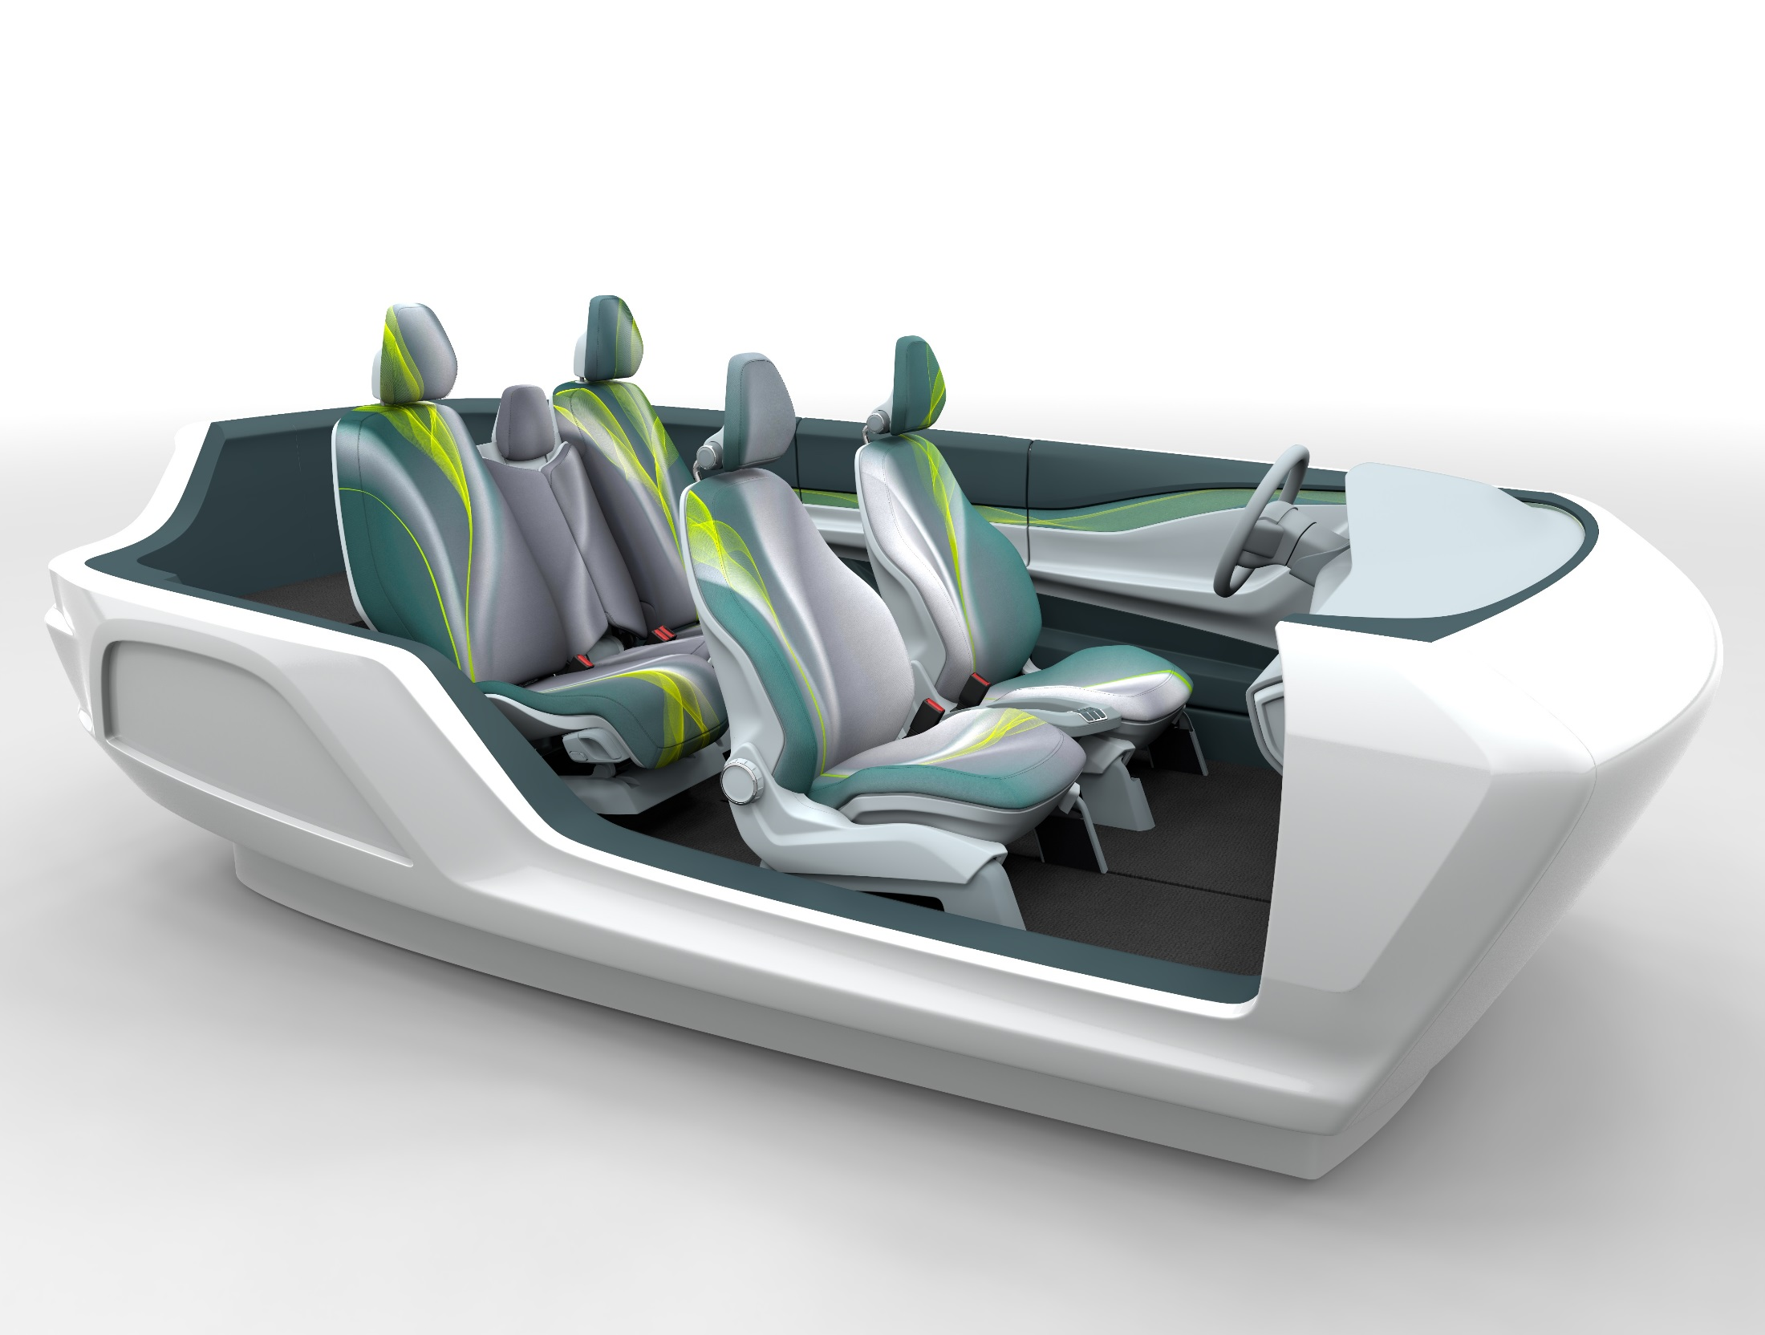

Adient Company Overview:
Global Leader in the Automotive Seating Market
$16.5B
Seating revenue in 2015
+ Non-consolidated
JVs
China $6.6B
Interiors $8.5B
22+ Million
seat sets a year
278
locations globally
Supports all major automakers globally in the differentiation of their vehicles

Slide 15
Substantial Value Creation for Shareholders
Value to Johnson Controls Shareholders
Value to Tyco Shareholders
Enhances multi-industrial portfolio by strengthening buildings platform
~56% equity ownership in value creation potential of the combined company including capitalized value of $650M of synergies plus substantial opportunities for enhanced revenues
~$3.9bn aggregate cash consideration in merger in addition to equity ownership
Strong pro forma balance sheet including enhanced financial flexibility
Stronger financial metrics (growth and profit) to drive multiple expansion over time
Premium of 13% to the 30 day volume weighted average share price exchange ratio
~44% equity ownership in value creation potential of the combined company including capitalized value of $650M of synergies plus substantial opportunities for enhanced revenues
More diversified larger portfolio with greater exposure to global higher growth regions and expanded opportunities in connected buildings of the future
Ownership of Adient as pure-play company post spin with significant free cash flow
Enhanced scale and cash flow to continue to pursue value-creating growth
A “Win-Win” Combination Strategically and Financially

Slide 16
Balanced Pro Forma Revenue Mix Provides Strong Base For Consistent Growth*
Balanced across products and geographies with strong recurring revenue base
*Post Adient spin

Slide 17













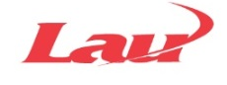




Leading Brands Across Comprehensive Portfolio of Products and Services
Building Controls
Energy & Power
HVAC Equipment
$32 billion
global leader
Security Products
Fire Products
Integrated Solutions & Services
#1 in Controls, Fire, Security and Power Solutions

Slide 18








Uniquely Positioned to Capitalize on Convergence
  SMARTER PLACES
  Smart Homes
  Smart Buildings
  Smart Cities
  Smart Operations
  - Retailers
  - Hospitals
  - Stadiums
  - Etc.
?
IoT!
Johnson Controls + Tyco Strength Across Converging Ecosystem
“Internet of Things” Expanding Existing Markets and Defining New Markets & Ecosystems

Slide 19
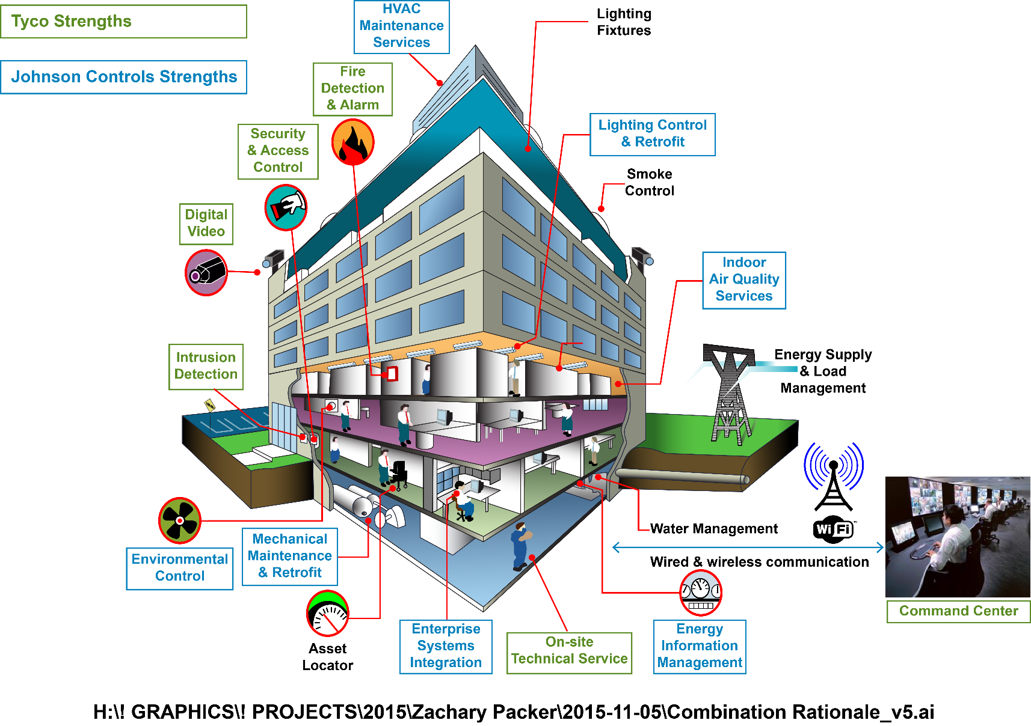
Combination Creates Ability to Deliver on Integrated Vision for Buildings of the Future
Advantaged Position for Building Automation and Systems Integration

Slide 20


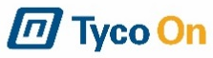


Combined Company Able to Leverage IoT and Connectivity for a “Smarter” Customer Offering
Information Technology
Energy Storage
Analyze data, Optimize energy effort, Enhance asset utilization
Distributed power, Renewables support, New Battery technologies
Uniquely Positioned For Integrated, Connected and Data-Rich Future
Building Technologies
Enterprise Assets
HVAC, Fire & Security, Lighting, and Power
Asset tagging, Tracking & management
Leader in Connected Buildings, Campuses and Cities

Slide 21
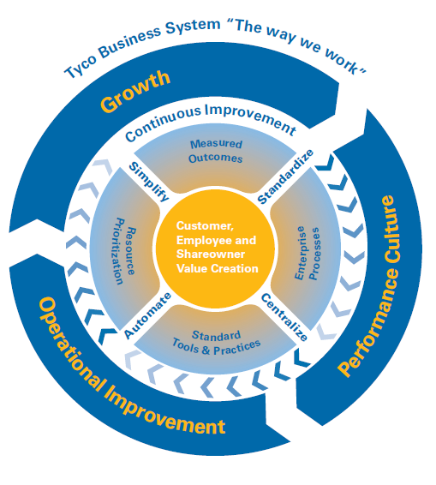
Two World-Class and Complementary Operating Systems
Johnson Controls Operating System
Tyco Business System
Business System
Procurement
Leader Led
Marketing
& Sales
Manufacturing
Engineering
Functional
Excellence
Supply Chain
P
Most operationally capable
P
Standardizes & optimizes all processes
P
Standardized enterprise approach
P
Drives efficient cost structure
P
Span all areas of business
P
P
Accelerates value extraction
Establish and leverage best practices
P
Consistent, repeatable processes
P
Prioritizes & allocates resources
P
Increase speed and agility
Two Strong Business Systems to Drive Synergy Realization and Efficiencies Across the Combined Organization

Slide 22
Financial Highlights
Revenue Growth
Accelerated top-line growth given product and service portfolio opportunity plus geographic growth opportunities
Earnings
$650M of synergies contribute to enhanced earnings growth
Operational synergies reach run rate by year three
Financing / Balance Sheet
Committed financing in place for ~$3.9B cash consideration in the merger
Strong investment grade balance sheet with financial flexibility
Dividend Policy / Capital Allocation
Strong free cash flow to support continuity of strong and growing dividends
Balanced capital allocation going forward including return of capital to shareholders plus high return investment

Slide 23
Fiscal Q1 Earnings Update
Johnson Controls
Expect adjusted EPS of $0.82 vs. guidance of $0.80 − $0.83
Johnson Controls will report its Q1 earnings on January 28th
Tyco
Expect EPS before special items of $0.42 vs. guidance of $0.40
Tyco will report its Q1 earnings on January 29th

Slide 24
Compelling Strategic Rationale
Creates new global leader with $32 billion in revenue (post Adient spin) uniquely positioned to provide the most comprehensive portfolio of building and energy platforms
Highly strategic combination creates the leading full-scale building products and services business, integrating best-in-class product, installation and service capabilities across controls, fire, security, HVAC, and power solutions
Transaction combines innovation pipelines for devices, controls, sensors, data analytics and advanced solutions to better capture the enormous “smart” market opportunity
Tyco and Johnson Controls have highly complementary businesses, enabling the combined company to offer comprehensive and innovative solutions to even more customers globally across various end markets
Combination accelerates ability to partner with customers to bring advanced building technology and integrated solutions for better overall performance and experience
Compelling value creation through at least $650 million in identified synergies plus substantial opportunities for enhanced revenue growth

