Slide 1
E2Open Multi-Collab View (MCV)

Slide 2
Viewing the Multi-Collab Pages
To view Multi-Collab pages:
From the menu, click Collaborative Supply Planning, and then click Search Forecast.
On the Search page, enter the search criteria to locate the collaborations to view, and then click Search.
The Collaboration Selector page appears.
Select the check boxes next to the collaboration(s) that you want to view.
Next to the View button, click the down arrow.
The list of available pages appears.
Notes:
Start on Page 28. How to Search & Respond to a Forecast.

Slide 3
Viewing the Multi-Collab Pages
Click the page that you want to view.
The page appears.
There are four Multi-Collab pages to view.
Users can navigate between pages while on any other page.
Click the down arrow next to the current page title.
The list of available pages appears.
Click the page that you want to view.
Notes:
Read whole slide

Slide 4
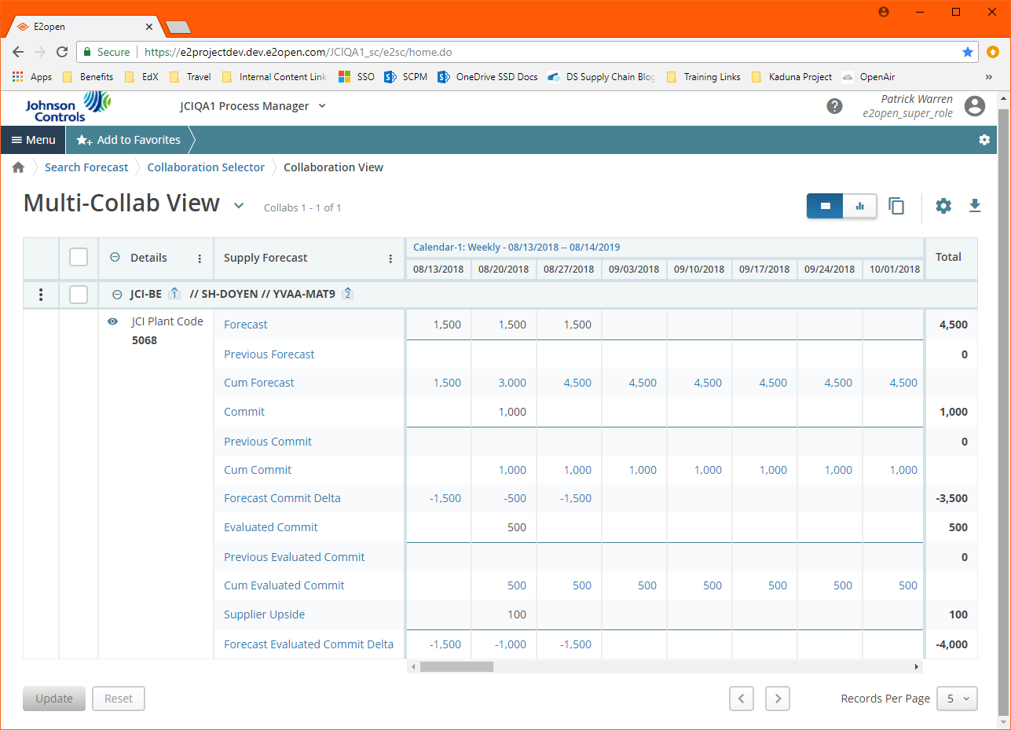
Multi-Collab View Page
The Multi-Collab View page displays the following information:
Collaborations Data
JCI Enterprise Code
Supplier
JCI Part Number
JCI Plant Code
Data Column
Indicates type of data available
Time Bucket Columns
Group data for a collaboration by
date
Time Bucket Columns
Collaboration Data
Data Column
Notes:
Read whole slide

Slide 5
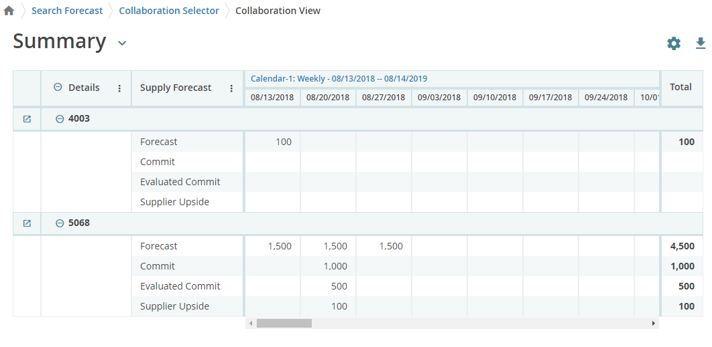
Summary Page
Notes:
Read whole slide

Slide 6
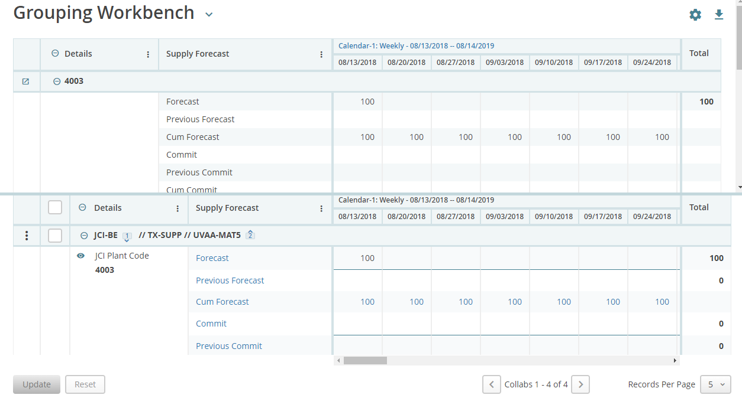
Grouping Workbench Page
Non-aggregated Data
Data that is unique for each point in time. Example, Forecast for a specific month.
Aggregated Data
Cumulative (added together) data over a period of time from today until the date of the cumulative value shown. Example, cumulative monthly forecast of 100 per month would be 300 at three months from today and 400 at four months from today.
Notes:
Read whole slide

Slide 7
Aggregated List Page
Notes:
Read whole slide

Slide 8
Calendar Controls Multi-Collab View Page Calendar
The calendar controls date range and date buckets for current search result pages.
To change calendar settings:
At the top of the page, click Calendar.
The Setting options appear.
Enter desired settings.
Start Date
End Date
Timeframe
Click Apply.
Settings remain while navigating to different pages of current search results; however, the calendar settings reset to the default calendar view upon next search.
Notes:
Read whole slide

Slide 9
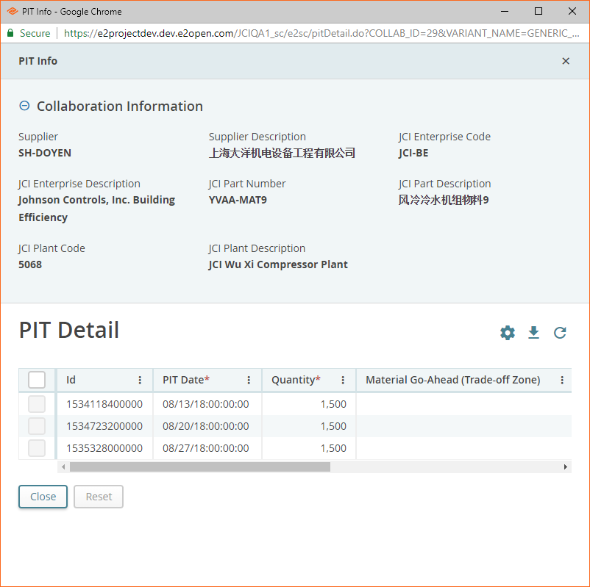
Time Bucket Details
Data consolidated into time buckets can be viewed by their original Point-in-Time (PIT) values.
To view PIT values:
Click the blue text hyperlinked data value.
Black text values are not consolidated data.
View the PIT values on the PIT Detail page.
Notes:
Read whole slide

Slide 10
Data Measures Aggregated and Non-Aggregated Data
Each page displays aggregated and non-aggregated data for selected collaborations.
Non-aggregated Data
Data that is unique for each point in time. Example, Forecast for a specific month.
Aggregated Data
Cumulative (added together) data over a period of time from today until the date of the cumulative value shown. Example, cumulative monthly forecast of 100 per month would be 300 at three months from today and 400 at four months from today.
Non-aggregated Data
Aggregated Data
Notes:
Read whole slide

Slide 11
Data Measures
Data measures
Standard data
Input via user interface or file upload.
Rollover data
Rolled over from existing data measures after an upload.
Aggregated (computed) data
Calculated by E2open.
Exceptions –
Problems flagged by E2open.
Color coded data value cells.
Based on pre-defined business logic.
Totals for most data rows in right side column
Standard
Rollover
Aggregated
Totals
Exceptions
Exceptions
Notes:
Read whole slide

Slide 12
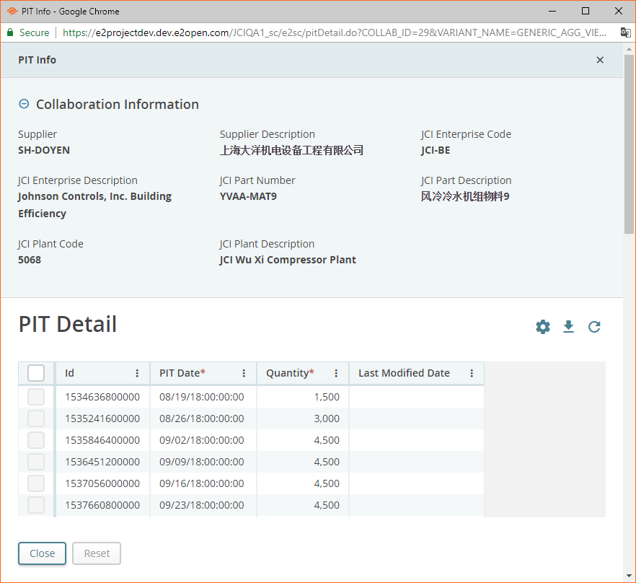
Data Measure Details
Click the blue text hyperlinked data measure label to view the PIT details.
Launches the PIT Detail window.
Notes:
Read whole slide

Slide 13
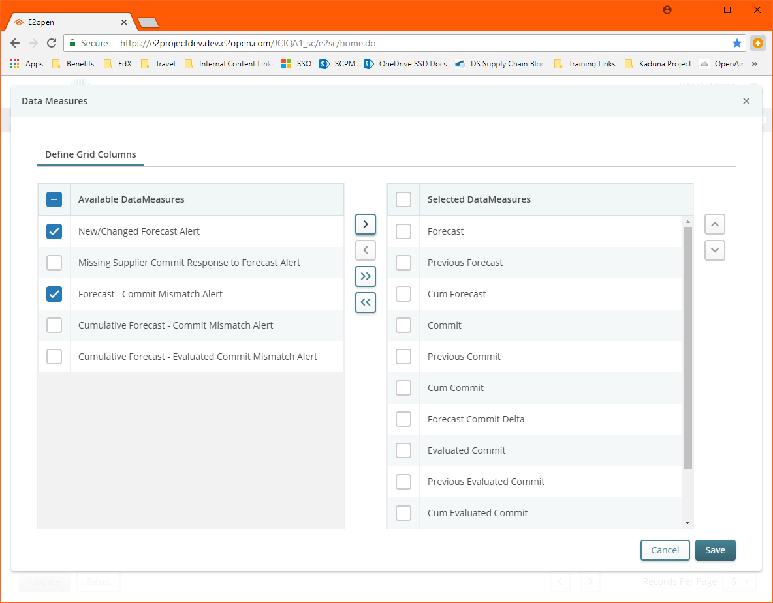
Data Measure Visibility
Data measures visibility is configurable.
To configure data measure visibility:
On the right side of Supply Forecast, click the three vertical dots, and
then click Select data measures.
To add data measures to view:
In left column, select the checkbox for desired data measures.
Click the right single arrow.
To remove data measures from view:
In the right column, select the checkbox for desired data measures
Click the left single arrow.
Double-arrow buttons [<<] and [>>] will move all items
between columns
Up [/\] and down [V] arrow buttons will determine the display order
Click Save.
Applies changes to current and all future sessions
Notes:
Read whole slide

Slide 14
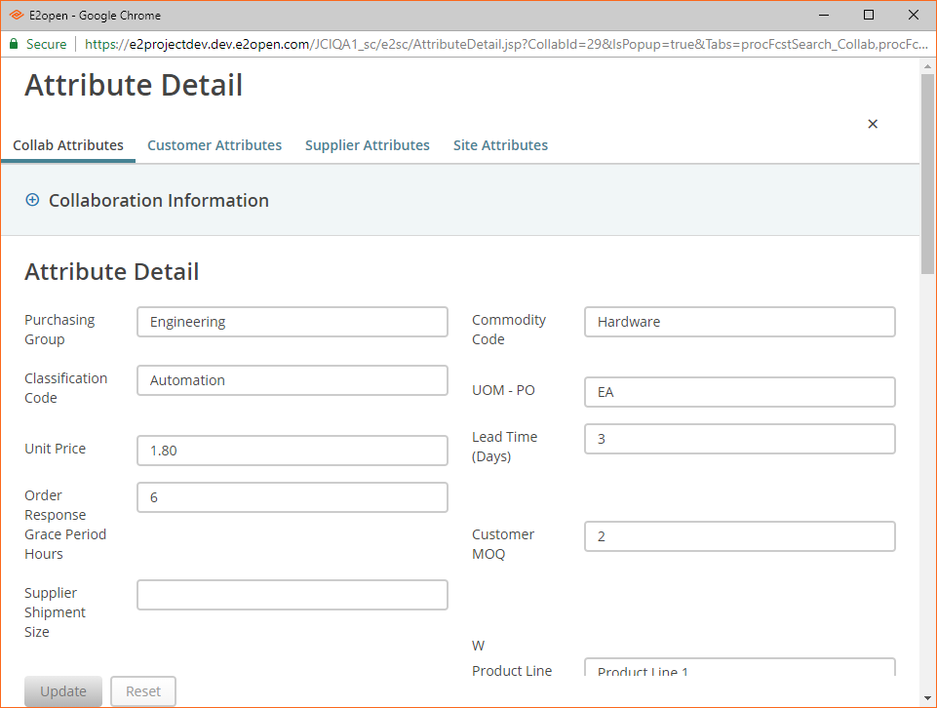
Attribute Details
Attribute details are available for each collaboration.
Available Attributes
Collab
Customer
Supplier
Site
To view attribute details:
On the left side of the collaboration, click the three vertical dots, and then click Attribute Details. The Attribute Detail page appears.
At the top of the page, click the appropriate tab to view details for each set of attributes.
Notes:
Read whole slide

Slide 15
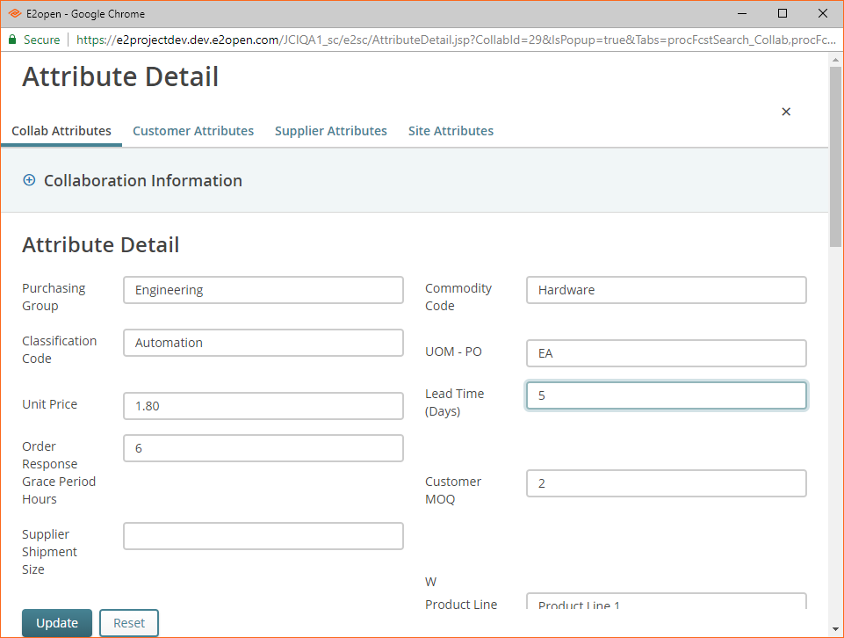
Edit Attribute Details
Click the tab for the attributes that you want to edit.
Collab Attributes
Used to override Customer or Supplier Attributes for the Collab
Customer Attributes
Used for customer specific attributes
Supplier Attributes
Used for supplier specific attributes
Site Attributes
Used for Site specific attributes
Change the attribute details.
Click Update.
Notes:
Read whole slide

Slide 16
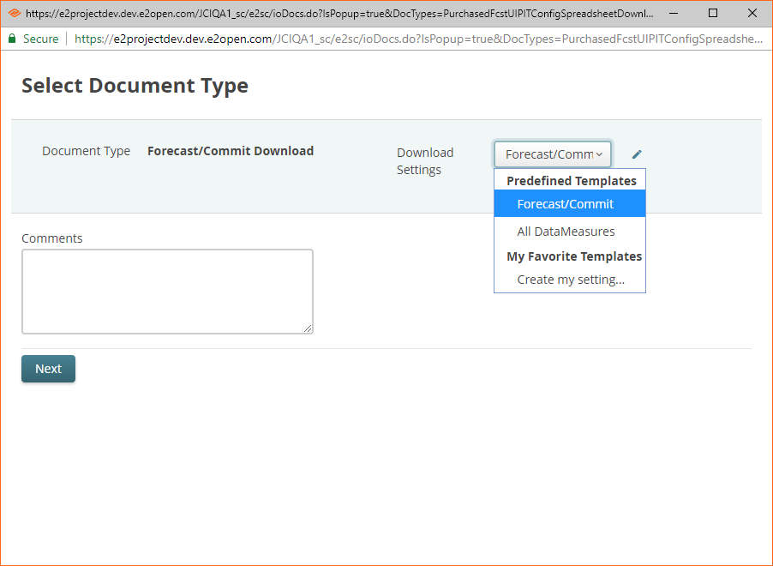
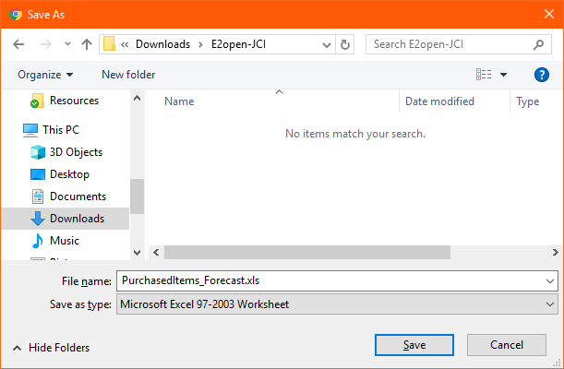
Download PIT Data in Excel® format.
To download PIT data:
On a Multi-Collab page, click the Download icon and then click File Download.
On the Select Document Type page, in the Download Settings list, select the appropriate template.
Click Next.
Click Save to save the file to your computer.
You cannot edit this file and upload the changes, use the Download menu for that purpose.
Notes:
Read whole slide

Slide 17
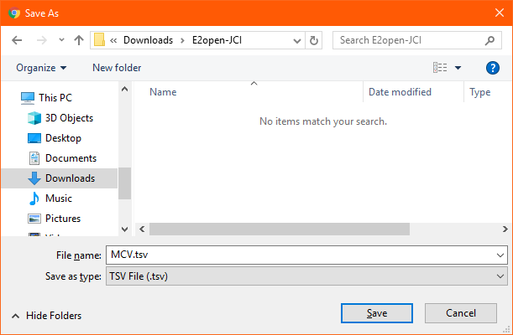
Download PIT Data in TSV Format
Tab separated values (TSV) files are used for spreadsheet software, including Excel.
To download PIT data:
On a Multi-Collab page, click the Download icon, and then click Export. The Save As page appears.
Navigate to and select the folder in which you want to save the file.
Click Save to save the file to your computer.
Notes:
Read whole slide

Slide 18
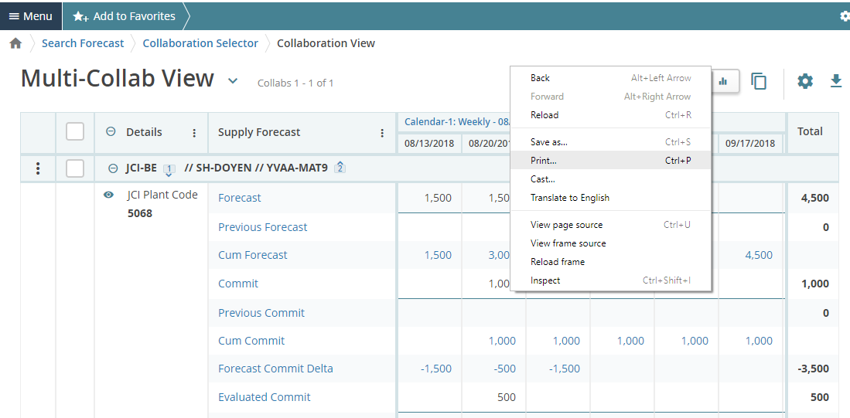
Multi-Collab View Tools: Multi-Collab View Print
To print an MCV page:
On the page, right-click, and then from the menu, click Print.
Note: For best results, use the Landscape setting.
Notes:
Read whole slide

Slide 19
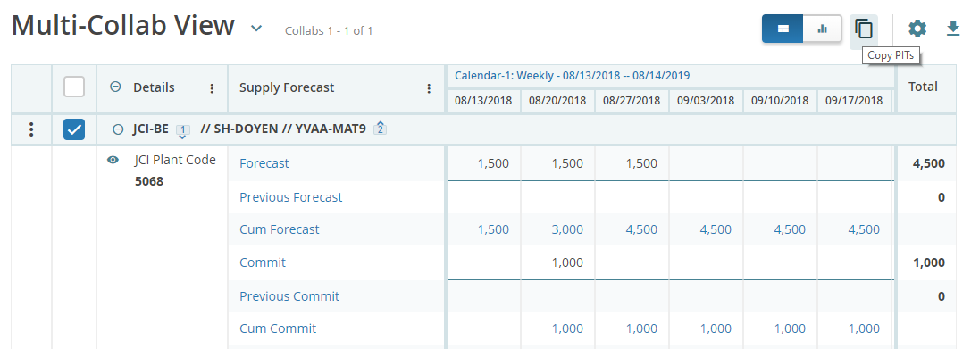
Copy PITs
This feature is available only if your are permitted to edit data directly on an MCV page.
To copy PITs:
On the MCV page, click the Copy PITs icon.
Notes:
Read whole slide

Slide 20
Copy PITs
In the Copy PITs dialog box, take the following actions:
Select the desired start and end dates.
In the Source list, click the data measure you want to copy.
In the Target list, click the data measure to which the data will be copied.
More than one target can be selected by repeating this step and selecting another target.
Your options for Source and Target are determined by your role.
If you want to copy the attributes, click the Copy Attributes check box.
Click Copy.
Notes:
Read whole slide

Slide 21
Copy PITs
Click x to close the Copy PITs dialog box. The data is refreshed and the copied PIT appears.
PIT data is copied from each source row to each target row for each Collab on the page.
Notes:
Read whole slide

Slide 22
E2Open Supply Forecast Planning

Slide 23
Supply Forecast Planning Overview
On a periodic basis (for example, weekly, monthly or quarterly), JCI forecast data is uploaded into E2open using the following methods: *** JCI data load into E2Open is Monthly ****
If forecast data are available in the JCI ERP system, the data (once ready) can be automatically synchronized to E2open via B2B connection.
If forecast data are not available in JCI ERP system, JCI users can manually upload the data into E2open directly, using a Microsoft® Excel template predefined by E2open.
Forecast data will be made available to suppliers once the data are loaded into E2open.
Based on the forecast published by JCI, the supplier is required to provide a response through the system user interface (UI) and/or Excel upload.
Suppliers can also provide the upside data to JCI via E2open web user interface, if there is additional capacity above the commit response.
CTB system is sending forecast (only those that were manually uploaded by JCI) and commit data from the supplier back to the JCI backend system via B2B connection.
Notes:
Read through Slide

Slide 24
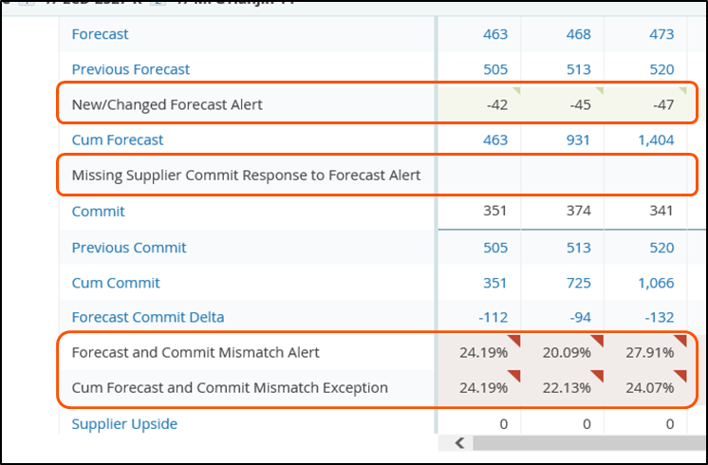
Collaborative Supply Planning Exception Alerts
The system triggers the following exceptions based on pre-defined business logic
Forecast Expectation Alerts
Forecast and Commit Mismatch Alert
Cumulative Forecast and Commit Mismatch Alert
Exception triggers when the commit data provided does not match the forecast data.
Cum Forecast and Evaluated Commit Mismatch Exception
Exception triggers when there is mismatch between forecast and evaluated commit.
Missing Supplier Commit Response to Forecast Alert
Exception triggers when the supplier is not providing a commit against the published forecast within 72 hours.
New or Changed Forecast Alert
Exception triggers when new or changed forecast data is uploaded into the system.
JCI buyers and suppliers are permitted to subscribe to these email alerts to be notified when these exceptions have been flagged.
Notes:
Read through Slide*** Mention this same information is also repeated on SLIDE 58

Slide 25
Collaborations
Collaboration (or collab) is the core building block of the system
Collabs have attributes that can be used for searching and data measures that extend collaboration
A collab is the combination of four master data elements:
Customer
Customer Site
Item
Supplier
Notes:
Read through Slide Mention this same information is also repeated on SLIDE 59

Slide 26
Collaborations
Example: ABC Co. – Plant 1 – Glass Part 123 – XYZ Supply Co.
Customer: Customer, for example, JCI-BE
Customer Site: Consumption Location or Distribution Center, Ship to Plant Code
Item: The item for which the sales forecast is published, for example, Glass Part 123
Supplier: Vendor with whom the customer is collaborating, for example, XYZ Supply Co.
Notes:
Read through Slide Mention this same information is also repeated on SLIDE 60

Slide 27
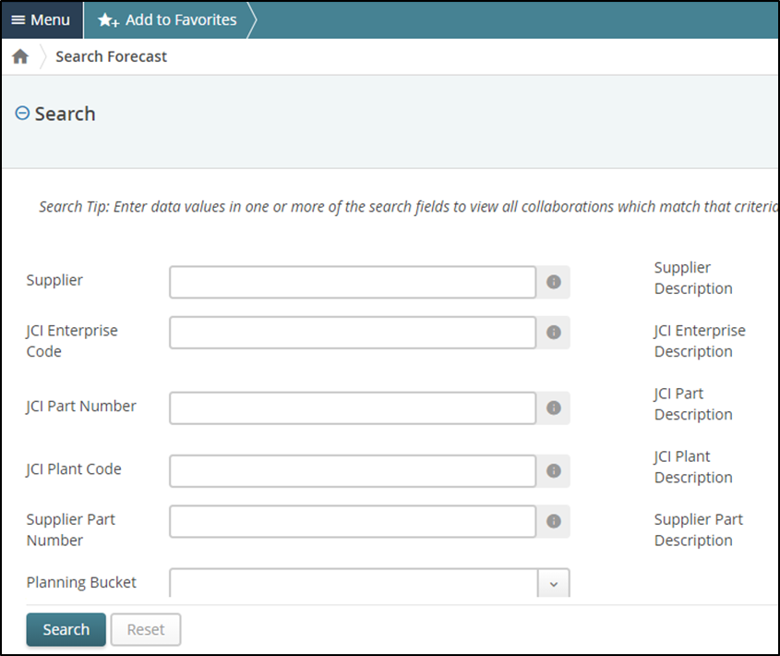
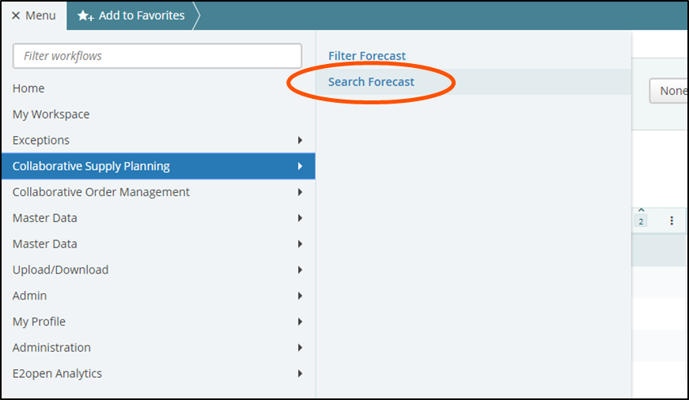
Viewing Collaborative Supply Planning Locating Items
Search
Best used when you know something particular about the item, such as number, name or description, that can be typed into the search fields.
Fields are case-sensitive except in auto- complete fields.
Notes:
Read through Slide Mention this same information is also repeated on SLIDE 61

Slide 28
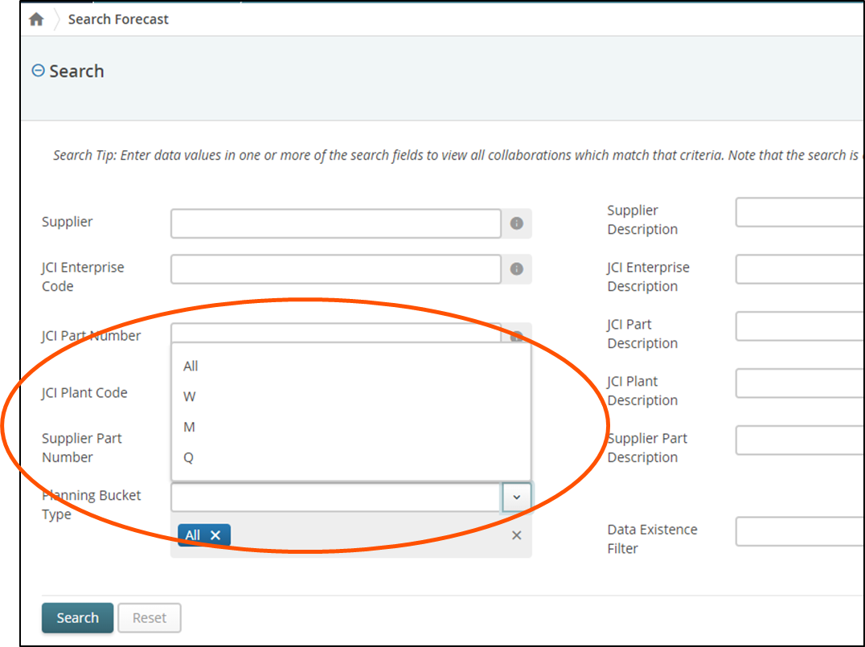
Search Forecast
In the menu, click Collaborative Supply Planning, and then click Search Forecast.
Enter your search criteria, and click Search.
Planning Bucket Type is a mandatory search field
Drop-down field options
All = All (Must also choose M, Q, or W)
M = Monthly
Q = Quarterly
W = Weekly
***** The data that was loaded into E2Open was configured at Monthly
Bucket so if you select the other buckets you will see in Monthly****
The selection of Planning Bucket Type determines your search results displayed in the system.
For example, selection of planning type “M” will call out all items categorized under Monthly cycle
Notes:
This is where you begin to explain "How to search & Respond to a Forecast. Read through Slide

Slide 29
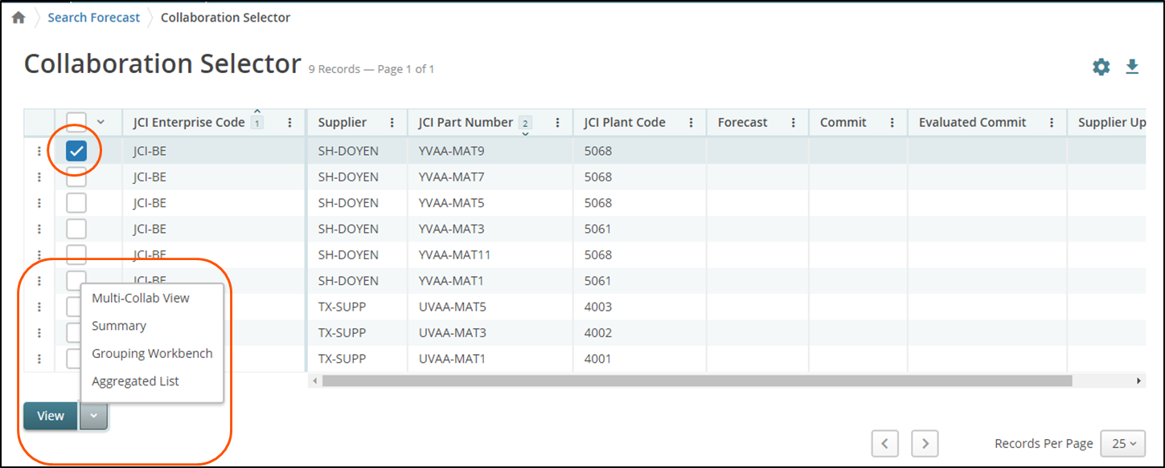
Forecast Collaboration View
Select the checkbox to select an item.
Click View and then click Multi-Collab View
Note that the columns to the right of Customer Site, (Forecast, Commit, etc.), will display totals starting from today for the default current time bucket on the MCV detail page.
Multiple suppliers can be selected while searching for a specific part and multiple parts can be selected while searching for a supplier.
Notes:
Read through Slide

Slide 30
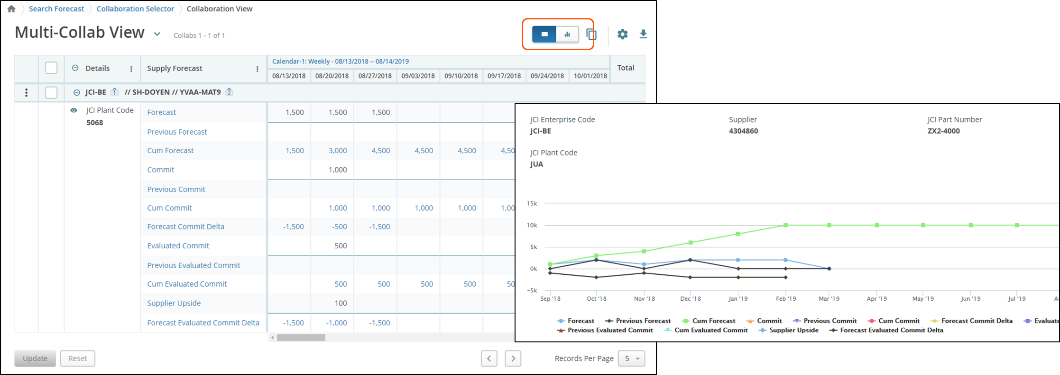
Forecast Collaboration View
When the Multi-Collab View (MCV) page appears, you can use view buttons to switch between table or chart views
Notes:
Skip slide

Slide 31
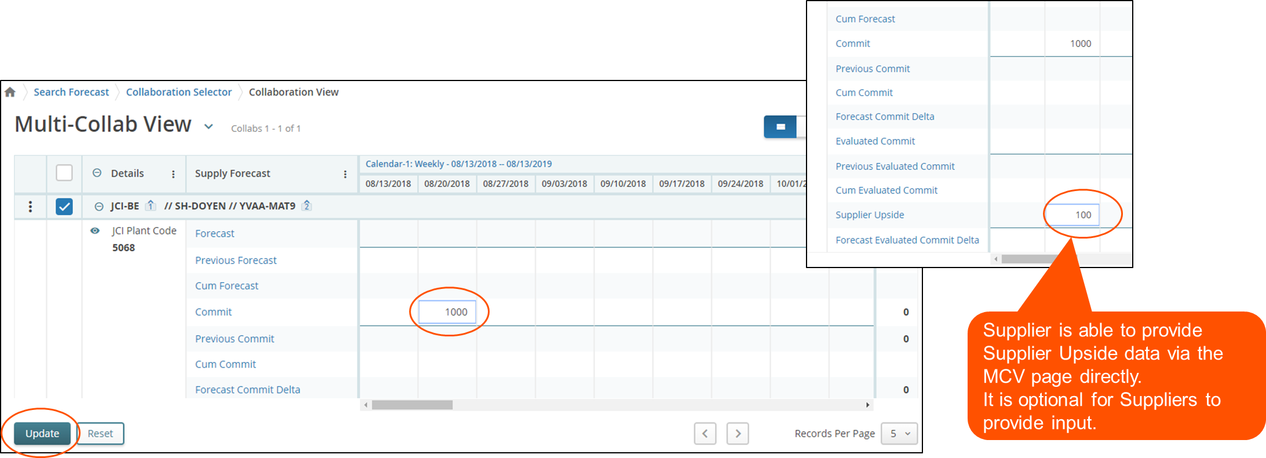
Update Commit (Suppliers)
Suppliers are required to respond against the published forecast data.
Navigate to the MCV page of the preferred collab.
Enter commit data, and click Update.
Notes:
Read through Slide - This ends "How to Search & Respond to a Forecast.

Slide 32
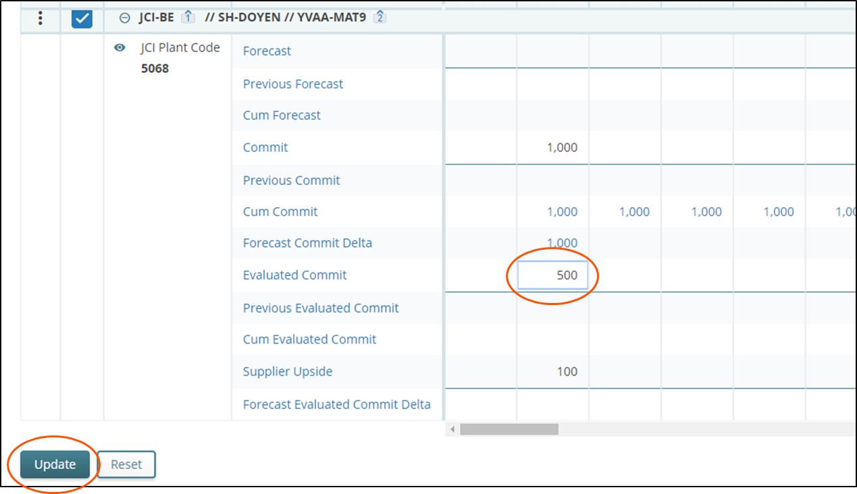
Providing Evaluated Commit (Buyer) Using the User Interface
JCI Buyer / Buyer Admin users are able to provide “Evaluated Commit” data directly through the user interface (UI).
Procedure
Navigate to the MCV page of the preferred collab.
Enter evaluated commit data and click Update.
Notes:
Skip

Slide 33
Forecast / Commit Data Rollover Logic
JCI uploads forecast data in a regular basis – either weekly / monthly or quarterly
When new forecast version is uploaded, E2open will perform roll-over action where:
The existing “forecast” data will be moved to “Previous Forecast” data line.
The existing “commit” data will be moved to “Previous Commit” data line.
The existing “evaluated commit” data will be moved to “Previous Evaluated Commit” data line.
The new forecast from JCI will be loaded into the “Forecast” data line
Within the same planning cycle (that is, in the same week, same month or same quarter), there might be different forecast versions (for the same item) provided by JCI, each individual forecast version is required to be stored in E2open Information Manager (IM) reporting database, for further reporting purpose
If there are multiple forecast versions sent to E2open within a same day, E2open will only store the latest version of the forecast within that day, there will be one forecast version per day
The Forecast Rollover action applies only to the individual collab that has the new data loaded.

Slide 34
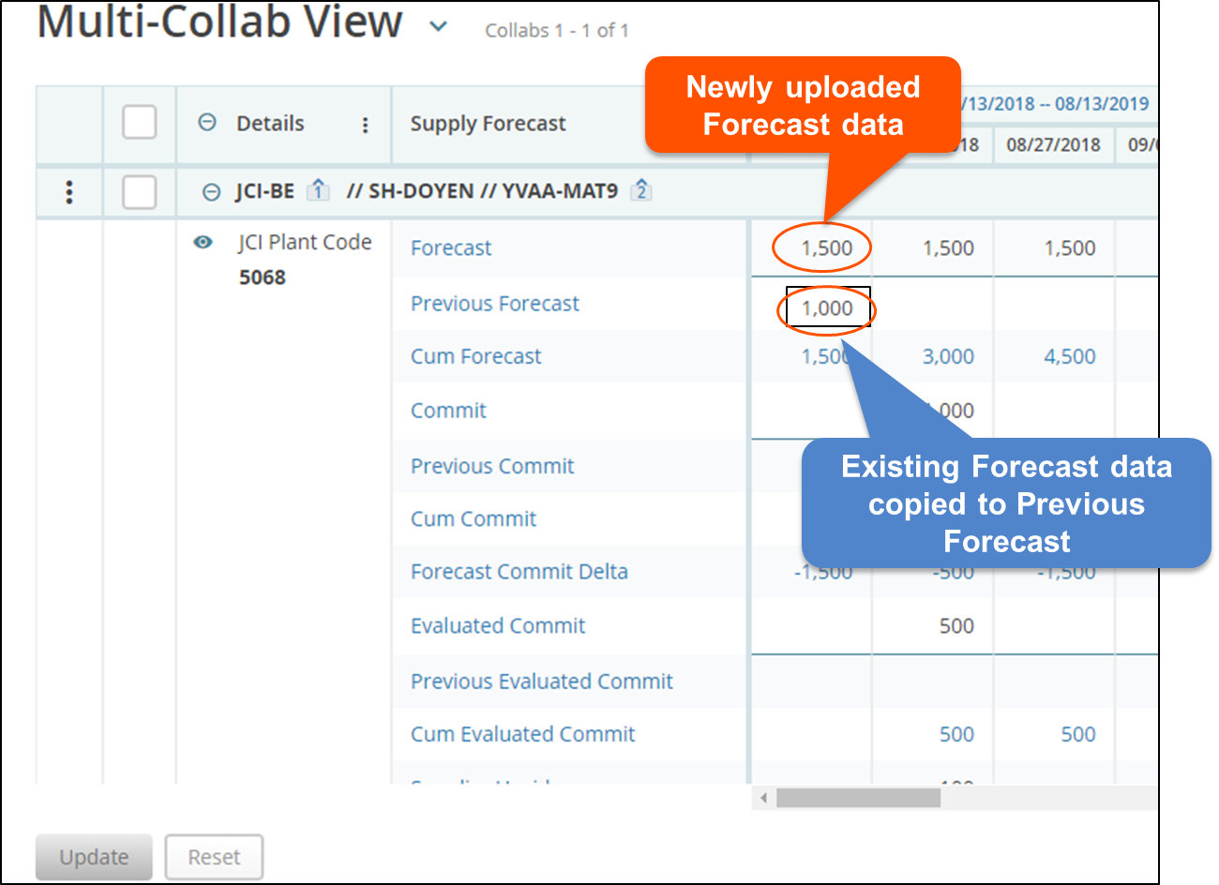
Forecast / Commit Data Rollover

Slide 35
E2Open Forecast/Commit Download, Edit, and Upload – Buyer and Supplier

Slide 36
Supply Forecast Planning
A JCI buyer can upload forecast data manually via a Microsoft® Excel® file.
Uploaded forecast data triggers the forecast data rollover action for collabs that have been updated.
A supplier can view and respond against the published forecast.
Commit and supply upside data can also be provided via uploaded Excel file.
Once the commit data provided by a supplier has been reviewed by JCI, a buyer can provide evaluated commit data for internal review.
Note: Evaluated commit data is only visible to JCI.
Notes:
Read through Slide

Slide 37
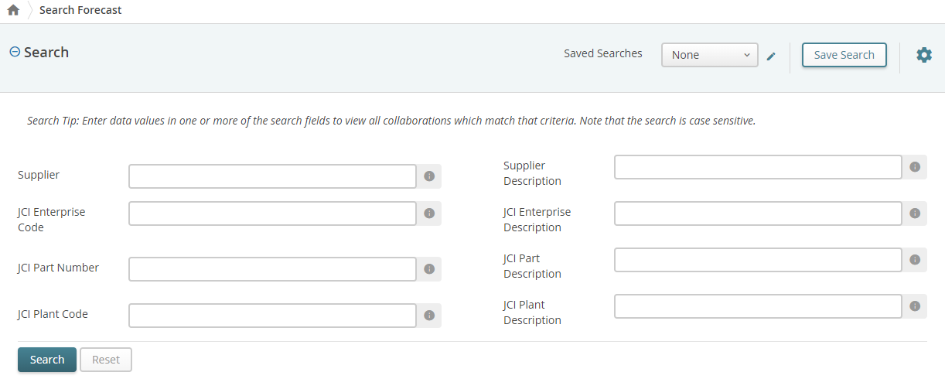
Forecast/Commit: Downloading from a List Page
Navigate to a list of preferred items.
Click Menu, click Collaborative Supply Planning, then click Search Forecast.
The expanded Search panel appears.
Enter your search criteria and click Search.
The Collaboration Selector list page appears.
Select the check box next to the collaboration that you want to download.
You can select multiple check boxes.
Click the Download icon and then click File Download.
The Select Document Type page appears.
Notes:
Read through Slide

Slide 38
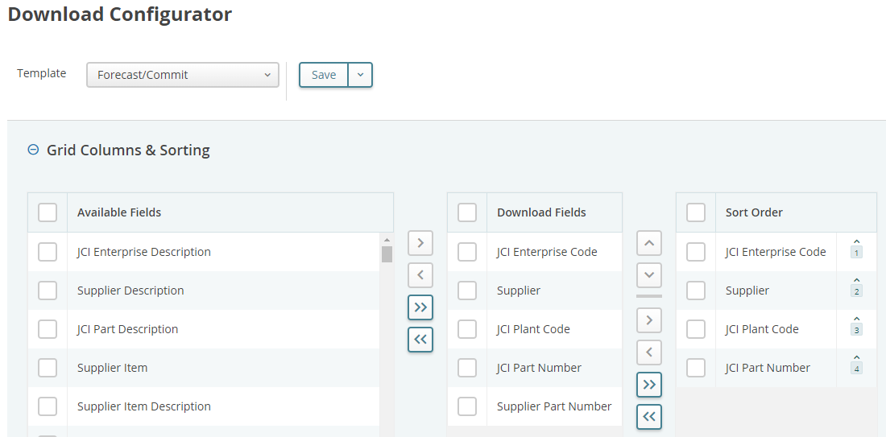
Downloading from a List Page
In the Download Settings list, click the template type you want to use for the download.
Note: To edit the template:
Click the Edit icon.
The Download Configurator page appears.
In the Grid Columns & Sorting section, select the fields that you want to appear in the template.
Available Fields, Download Fields, Sort Order
In the Data Measures section, select the fields that you want to appear in the template.
Available Data Measures, Data Measures
Click the arrows to move the fields where you want them to appear in the template.
Notes:
Read through Slide

Slide 39
Downloading from a List Page
Scroll to the Timeline Settings section and enter the following:
In Relative Start Days, enter number of days prior to the value in the Based On field to start the timeline of downloaded data.
In Relative End Days, enter number of days after start date to include in the timeline of downloaded data.
In Based On, select today or the day of the week to base the Relative Start Days field.
In Timeline Patterns box, select the view for the returned data.
Example, Calendar view: Weekly Calendar
Click Close.
The Select Document Type page reappears
Notes:
Read through Slide

Slide 40
Downloading from a List Page
7. Optionally, in Comments, enter any comments.
For example, if you execute multiple downloads, entering "next 90 days" or "next 90-180 days" will help differentiate your downloads
8. Click Next. automatically, or you may see a dialog asking whether you want to save the file or open it with a speci
What happens next is dependent on your browser. The file may be downloaded fic application.
Notes:
Read through Slide

Slide 41
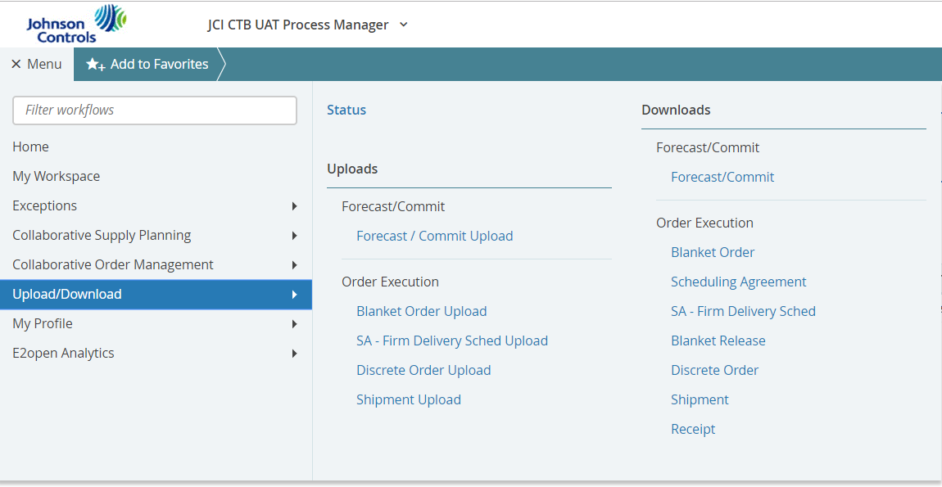
Downloading from the Menu
Click Menu, click Upload/Download, and then click Forecast/Commit under Downloads – Forecast/Commit.
Notes:
Talk through this whole slide

Slide 42
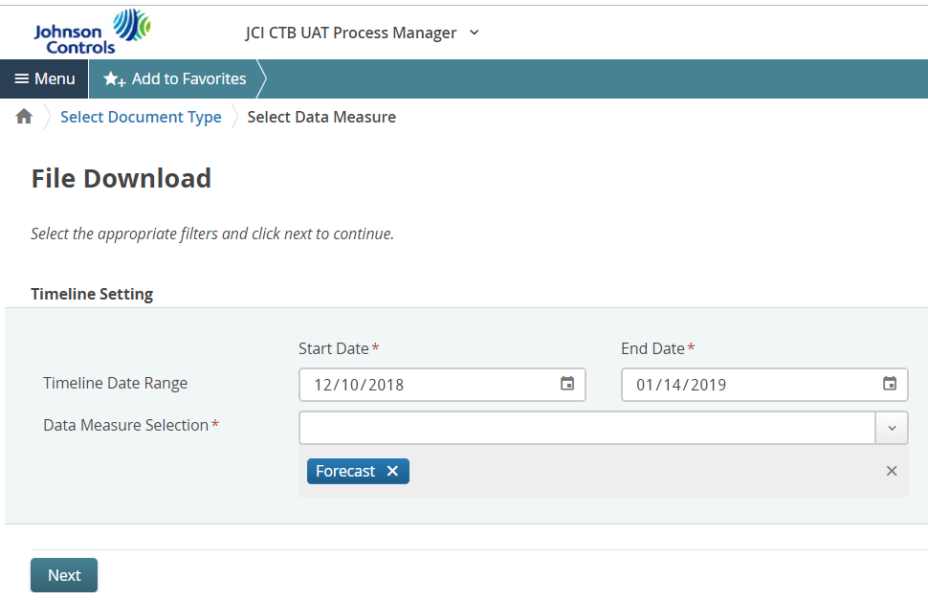
Downloading from the Menu
File download. Select the Time Data Range (you can select up to one year).
Note: In Data Measure Selection, Select Forecast, also you can select one or more options.
Click Next to continue.
Notes:
Talk through this whole slide

Slide 43
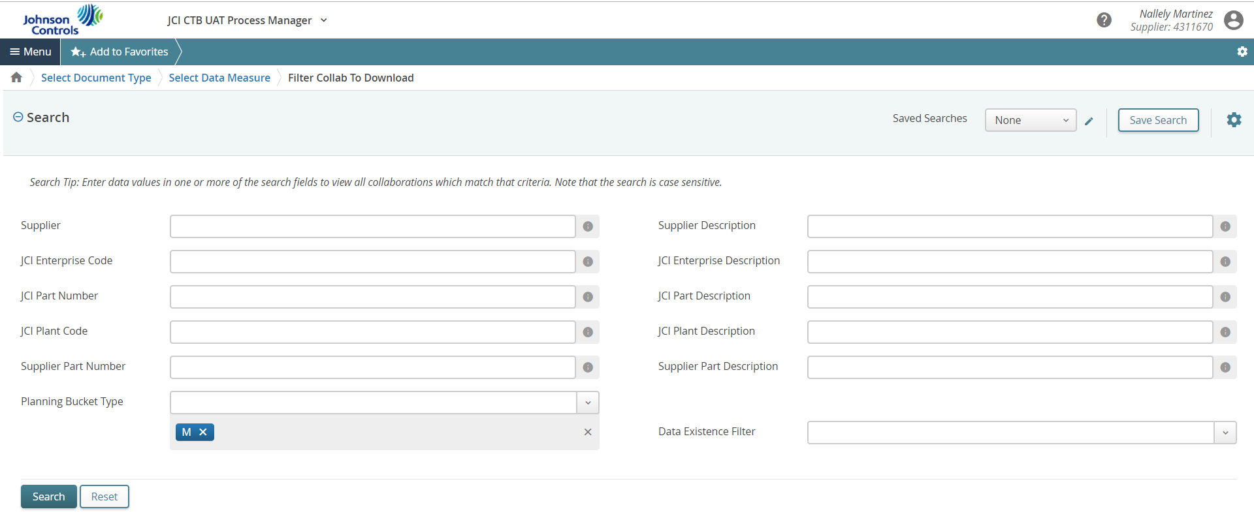
Downloading from the Menu
Enter your Search criteria to Filter Collab to download and click Search to Download.
Planning Bucket Type is a mandatory search field. You must select M.
Drop-down field options
All = All (Must also choose M, Q, or W)
M = Monthly
Q = Quarterly
W = Weekly
***** The data that was loaded into E2Open was configured at Monthly Bucket so if you select the other buckets you will see in Monthly****
Notes:
Talk through this whole slide

Slide 44
Downloading from the Menu
The Job List page appears with a confirmation message.
Wait until the job status changes to “Completed”.
The Job List will refresh every 10 seconds.
Notes:
Talk through this whole slide

Slide 45
Downloading from the Menu
Click the file name to download
What happens next is dependent on your browser and your settings. The file may be downloaded automatically, or you may see a dialog asking whether you want to save the file or open it with a specific application.
Note: In the downloaded file, if making changes that will be uploaded into the E2open system, do not rearrange columns and ensure that all required columns are filled out completely.
Notes:
Talk through this whole slide

Slide 46
Edit Downloaded File
Note: In the downloaded file, *****do not rearrange columns and ensure that all required columns are filled out completely. ******
The following are required:
Customer name: JCI-BE
Supplier Name: Supplier #
Customer item Name: Part #
Site Name: Your Plant Code
Data Type: Forecast
Quantity: Needed quantity for the desired week
Date: It has to be every Monday
See the next instructions to copy existing part numbers and other data into this file.
Notes:
Read through Slide emphasize *****do not rearrange columns and ensure that all required columns are filled out completely. ******

Slide 47
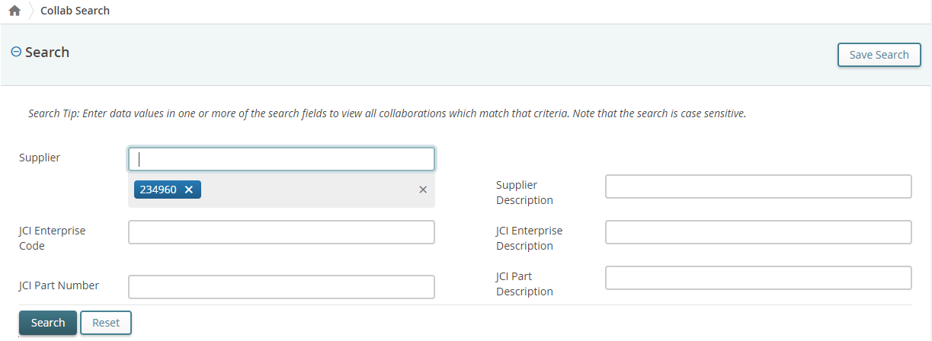
Edit Downloaded File – Copy Existing Data
Click Menu, click Master Data, then click Edit Collab Attributes.
Enter search data.
Desired Supplier #
Planning bucket type “M”
Click Search.
A list of JCI Part Numbers provided by the supplier will be displayed.
Notes:
Read slide

Slide 48
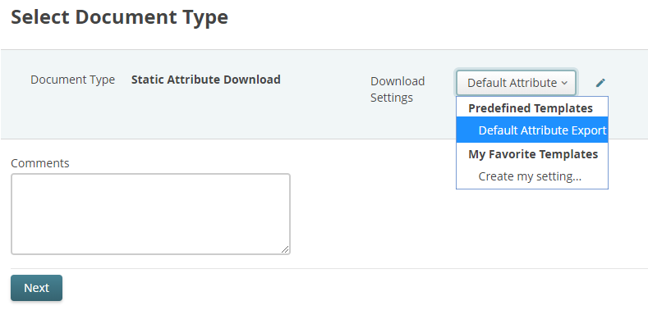
Edit Downloaded File – Copy Existing Data
Click the download button to download a spreadsheet of the results.
If not already selected, select Default Attribute Export from the Download Settings drop-down.
Optionally, in Comments, enter any comments.
Click Next.
What happens next is dependent on your browser. The file may be downloaded automatically, or you may see a dialog asking whether you want to save the file or open it with a specific application.
Notes:
Read slide

Slide 49
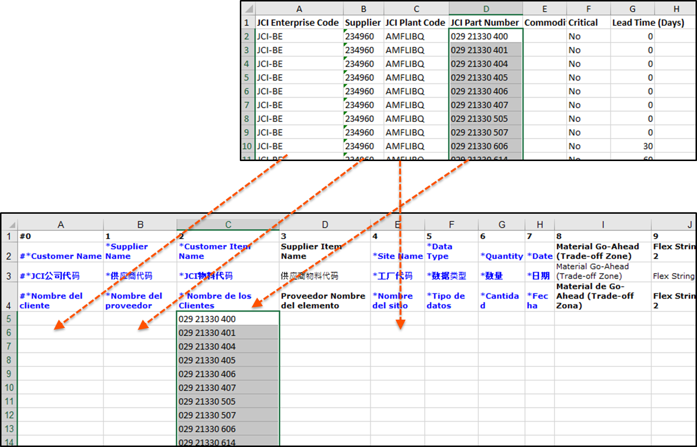
Edit Downloaded File – Copy Existing Data
Open the downloaded file.
Copy the Part number column and paste it into the *Customer Item Name column.
Repeat the process for the other columns.
Save the file.
Notes:
Read slide

Slide 50
Updating Commit Data against the Published Forecast (Offline): Supplier Action
Download forecast data into an Excel file (See download steps above).
In the downloaded Excel file, change the Data Type to Commit.
Note: In the downloaded file, do not rearrange columns and ensure that all required columns are filled out completely.
Click Save.
Notes:
Go through slide

Slide 51
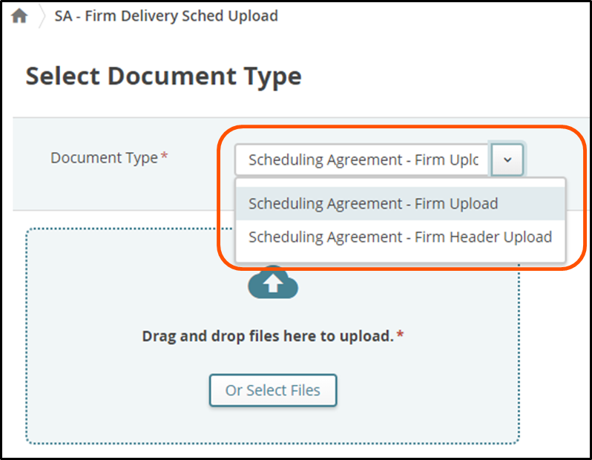
Uploading Forecast Data via Excel File (Supplier)
In the system, click Menu, click Upload/Download, then click Forecast/Commit Upload under the Upload Forecast / Commit options.
In the Document Type box, click the type of document you are uploading.
Notes:
Read through slide

Slide 52
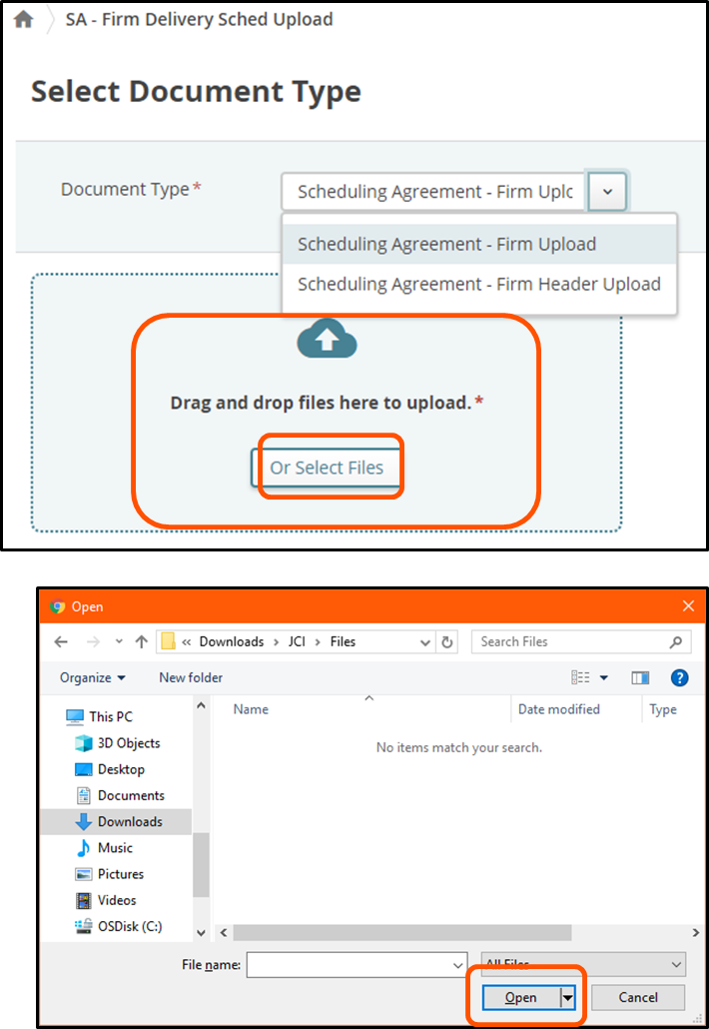
Uploading Forecast Data via Excel File (Supplier)
Upload your file.
Drag-and-drop a file to be uploaded to the drag and drop box.
OR
Click Or Select Files.
The File Upload dialog box appears.
Click the file you want to upload and click Open.
The name of the file appears under the drag-and-drop box.
Optionally, type any comments.
Click Next.
The Job List page appears and displays the upload status and a confirmation message.
Notes:
Read through slide

Slide 53
Collaborative Supply Planning Exception Alerts
The system triggers the following exceptions based on pre-defined business logic
Forecast Expectation Alerts
Forecast and Commit Mismatch Alert
Cumulative Forecast and Commit Mismatch Alert
Exception triggers when the commit data provided does not match the forecast data.
Cum Forecast and Evaluated Commit Mismatch Exception
Exception triggers when there is mismatch between forecast and evaluated commit.
Missing Supplier Commit Response to Forecast Alert
Exception triggers when the supplier is not providing a commit against the
published forecast within 72 hours.
New or Changed Forecast Alert
Exception triggers when new or changed forecast data is uploaded into the system.
JCI buyers and suppliers are permitted to subscribe to these email alerts to be notified when these exceptions have been flagged.
Notes:
No need to Read through slide this same information is also repeated on SLIDE 27

Slide 54
Forecast Collaboration View
In the Multi-Collab View (MCV) page, you can use view buttons to switch between table or chart views
Notes:
No need to Read through slide this same information is also repeated on SLIDE 33

Slide 55
Update Commit (Suppliers)
Suppliers are required to respond against the published forecast data.
Navigate to the MCV page of the preferred collab.
Enter commit data, and click Update.
Notes:
No need to Read through slide this same information is also repeated on SLIDE 34

Slide 56
Forecast / Commit Data Rollover Logic
JCI uploads forecast data in a regular basis – either weekly / monthly or quarterly
When new forecast version is uploaded, E2open will perform roll-over action where:
The existing “forecast” data will be moved to “Previous Forecast” data line.
The existing “commit” data will be moved to “Previous Commit” data line.
The existing “evaluated commit” data will be moved to “Previous Evaluated Commit” data line.
The new forecast from JCI will be loaded into the “Forecast” data line
Within the same planning cycle (that is, in the same week, same month or same quarter), there might be different forecast versions (for the same item) provided by JCI, each individual forecast version is required to be stored in E2open Information Manager (IM) reporting database, for further reporting purpose
If there are multiple forecast versions sent to E2open within a same day, E2open will only store the latest version of the forecast within that day, there will be one forecast version per day
The Forecast Rollover action applies only to the individual collab that has the new data loaded.
Notes:
No need to Read through slide this same information is also repeated on SLIDE 36

Slide 57
Forecast / Commit Data Rollover
Notes:
No need to Read through slide this same information is also repeated on SLIDE 37

Slide 58
Getting Support
Help desk support for both internal and partner users is typically provided by the organization that invited you to use the E2open solution. You can contact JCI through email at CG-e2open-ob@jci.com at any time this mailbox is monitored by the whole JCI onboarding team. This is our preferred method of contacting us
JCI is also available by calling into our Hypercare Hotline on Tuesdays, Thursdays & Fridays from 9:00am - 11:00am CST at 414-214-4100 Code 80685422.
Supplier Training will be held on Wednesdays from 9:00am - 11:00am CST at 414-214-4100 Code 80685422.
Johnson Controls Inc.-INTERNAL-(Peter Daniel)
Notes:
Talk through this whole slide

