Slide 1

E2Open Solution Overview

Slide 2

JCI E2Open
E2Open Solution Overview
System Overview
Registration and Access
Johnson Controls Inc.-INTERNAL-(Peter Daniel)
Notes:
E2Open is a cloud based system that will allow JCI Supplier Schedulers to transmit PO's electronically to our suppliers. The first section of the training will cover the System Overview, registration, how to access & login & password reset.

Slide 3


Order Management Process Workflow
Supplying
Enterprises
Ordering Process
Buying
Sites
Discrete/Scheduling Agreements/Order Changes
Order Responses
Fulfillment Process
Shipment/ASN
Receipt Notification
Business Objects
Discrete Order, Scheduling Agreements
Advance Shipment Notice
Goods Receipt
Johnson Controls Inc.-INTERNAL-(Peter Daniel)
Notes:
This is the Process Workflow which has two steps: 1. Order Process shows JCI on the right right/the Supplier on the left. JCI will send orders electronically to E2Open in the form of Discrete PO's and/or Scheduling Agreements. You the supplier will respond to the orders by acknowledging & confirming the orders. 2. The Fulfillment Process: You the supplier will ship the order to the JCI Plant & attach the Mandatory Advanced Ship Notice (ASN) to the shipment. JCI will receive the order & notify you the supplier that we received the shipment.

Slide 4
Getting Help
It is recommended to use Google Chrome as your browser for E2Open .
Pop-up blocker software can prevent certain functions from occurring
Temporarily disable pop-up blocker software:
  Press the Alt key while clicking any links - for Windows®
  Press the Ctrl key while clicking any links - for many third party applications
The permanent fix is to configure your browser to allow all pop-ups from e2open.com
  See the System Requirements document for detailed information
Johnson Controls Inc.-INTERNAL-(Peter Daniel)
Notes:
When accessing E2Open, it is recommended that you use Google Chrome as your browser. Also, we ask that you temporarily disable pop-up blocker software, because it can prevent certain functions from occurring. The instructions are listed on the PowerPoint document.

Slide 5
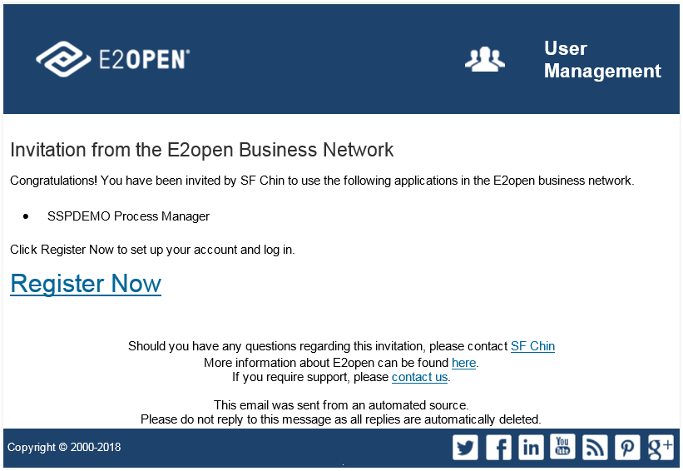
Self Registration
You will receive an email from your supplier scheduler advising you of your GO LIVE DATE.
2. You can expect an invitation within 24 hours
3. The email will come from do NoReply@e2open.com. If you are expecting an invitation and do not see it in your email please check your SPAM & JUNK folder or contact your IT if a firewall is preventing you from getting the invite.
2. When you receive your email invitation, click Register Now.
Johnson Controls Inc.-INTERNAL-(Peter Daniel)
Notes:
Self Registration: You will receive an email letter from your Supplier Scheduler with your Go-Live Date. Next, you will receive an email invitation requesting you to register into E2Open. It will come from "Do Not Reply". This is a sample of the email invitation. After receiving the email invitation, click the hyperlink "Register Now". If you do not receive the email, please check your SPAM and/or JUNK folders and also check with your IT person to make sure there are no firewalls blocking you from receiving these types of emails & let us know you did not receive the invitation.

Slide 6
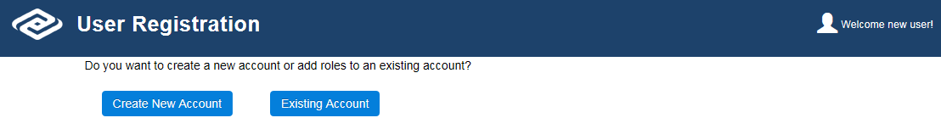
Self Registration
2. Click New Account or Existing Account as appropriate.
  Clicking Create New Account will display the User Registration page.
    ****If you have an E2open Process Manager user account as a Supplier for another company, you will still need to create a new account FOR Johnson Controls.
  Clicking Existing Account will display the Login page.
    Use this option if you are an existing user with JCI with any other JCI locations
Johnson Controls Inc.-INTERNAL-(Peter Daniel)
Notes:
If you are new to the E2Open system, select the "Create New Account" button. This will take you to the "User Registration" page. If you already use E2Open for another JCI plant, simply click the "Existing Account" button. This is take you directly to the Login page. Note: If you have an E2Open Process Manager user account as a Supplier for another company, you will still need to create a New Account for Johnson Controls.

Slide 7
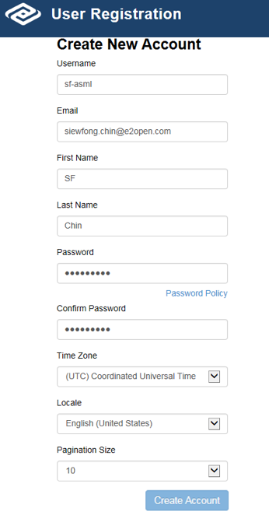
Self Registration – New Account
Enter the following information:
  Username: Username is your email address in lower case.
  Email: Your email address in lower case.
    Note: Exception Alert/ Notification is delivered to your registered email address.
  Your First Name
  Your Last Name
  Password/Confirm Password
    Note: Click the Password Policy link to see the password criteria
  Time Zone: Select your time zone
  Locale: Select your language preference
    Pagination Size: Select the number records the UI will display per page
    Note: The default is 10. Some applications will override this selection
Click Create Account.
Passwords must be changed every 90 days. If you are an occasional user, it is recommended you save your password in an easy to locate place.
Johnson Controls Inc.-INTERNAL-(Peter Daniel)
Notes:
For those who selected the "Create New Account" button, you will need to register. Complete all the fields in the "User Registration" box. Your "Username" is your email address in lowercase. Email address in lowercase, First name, last name, create a password, you can click the Password Policy button for password requirements, select your time zone, your language & pagination size. When you're done completing the registration, click the "Create Account" button.

Slide 8
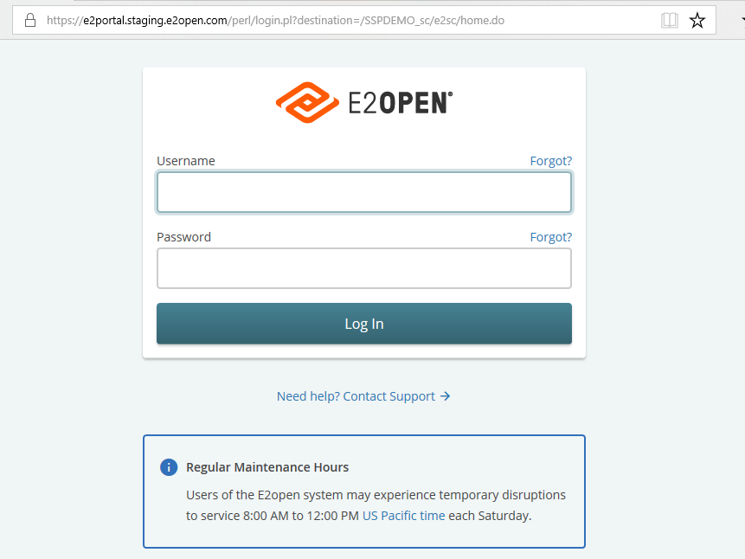
Logging in to the System
In your browser Address box, type the URL for your system.
  https://johnsoncontrols.e2open.com
On the system login page, take these actions:
  Type your username.
    Is Your Email address in lower case
  Type your password.
  Click Log In.
Johnson Controls Inc.-INTERNAL-(Peter Daniel)
Notes:
In your browser, type the URL shown: https://johnsoncontrols.e2open.com. We ask that you save the URL as a Favorite on your browser for easy access to login. Begin logging in, by typing your "Username", which is your email address in lowercase & the password you created. Click "Log In".

Slide 9
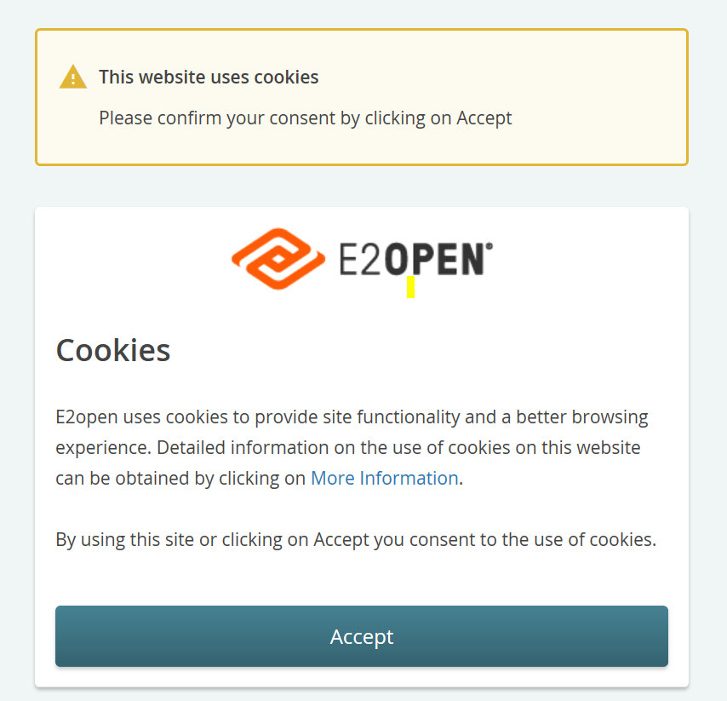
This website uses cookies
When you open E2Open Portal, you should Accept to use of cookies.
Notes:
Click the "Accept" button to accept cookies.

Slide 10
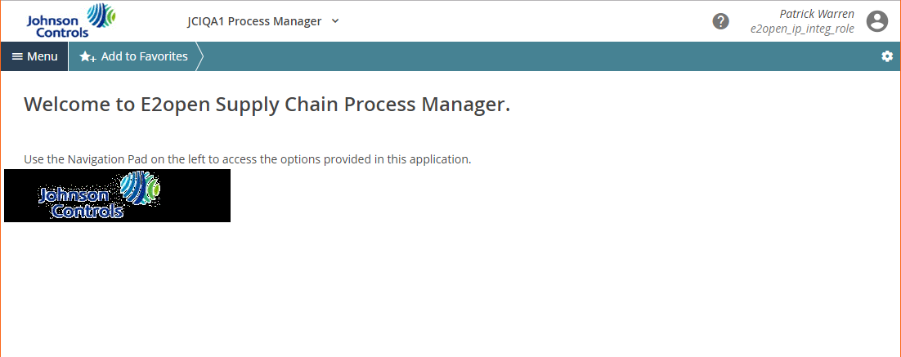
Process Manager, the Welcome page appears.
Johnson Controls Inc.-INTERNAL-(Peter Daniel)
Notes:
This is the first screen you should see, which is the E2Open Welcome page.

Slide 11
E2Open Getting Started

Slide 12
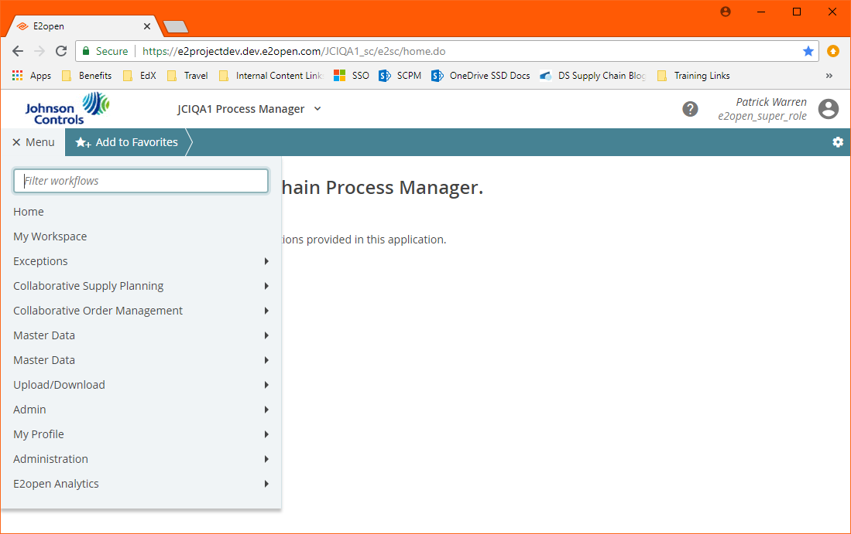
System Layout
Sections
  Header
  Menu
  Favorites
  Screen Display
Header
Favorites Bar
Menu
Screen Display
Johnson Controls Inc.-INTERNAL-(Peter Daniel)
Notes:
This is the System Layout page. It consists of a Header, which list your name & role (Supplier ID #), there is a Favorites Bar, where you can move menus to access quicker, the left side is called the "Navigation Tree" and that displays all the menus available & the white space is called the "Display Screen" and this is where the work takes place.

Slide 13
Header
Help
User
Role
Johnson Controls Inc.-INTERNAL-(Peter Daniel)
Notes:
The Header: User is your name & role. The Help button is the question mark & will be discussed further in the presentation.

Slide 14
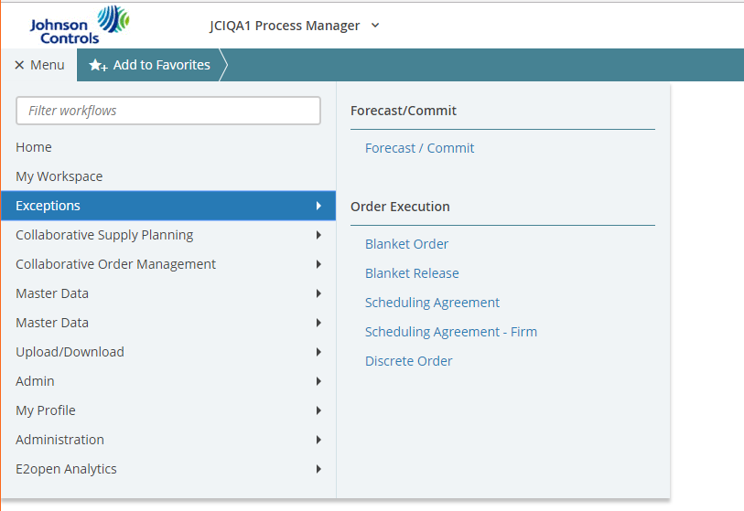
Menus
You navigate throughout the system using the Menu
Access to specific functionality is role-dependent
  Click the menu options on the Menu to view a submenu of related
  functions
  Click Home to return to your
  initial start page
Johnson Controls Inc.-INTERNAL-(Peter Daniel)
Notes:
Menu is where you navigate throughout the system, along with submenus. If you click the "Home" button it will take you back to the initial start page.

Slide 15
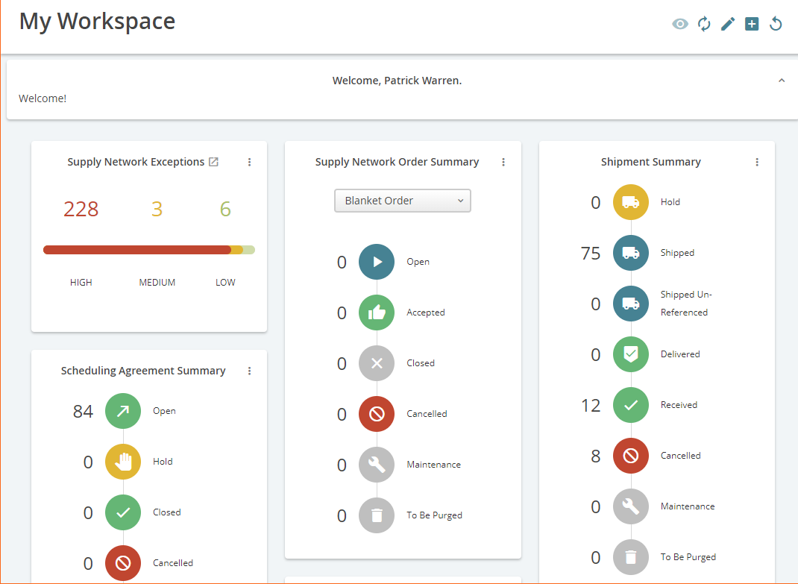
My Workspace
Your customized starting point for working in the system. These are called Cards, further in our training we will discuss in detail how each card works.
Overview of exceptions
Overview of number of orders in each state
Data is hyperlinked
  Takes users to search results for all orders with selected state
Customizable
Johnson Controls Inc.-INTERNAL-(Peter Daniel)
Notes:
My Workspace is the starting point for working in the system and has what are called Cards. There is an Exceptions card, overview of numbers in each state on a card, the data is hyperlinked and each card is customizable.

Slide 16
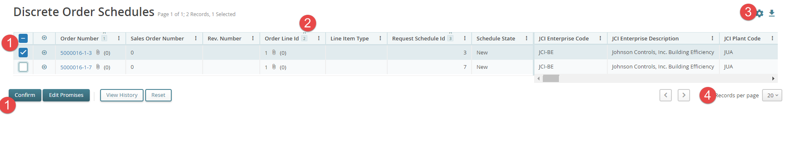
Working with Lists - All list are the same in E2Open
Check boxes and button options
Sorting, sort order
Configure view
Pages
We will show you here all the features of list in the tool
Johnson Controls Inc.-INTERNAL-(Peter Daniel)
Notes:
When working with lists, #1 shows you can check boxes & button options, #2 you can sort in Ascending or descending order, #3 by clicking the "Gear" icon, you can configure your view & #4, you can use the arrows to go from page to page & select the # of records per page.

Slide 17
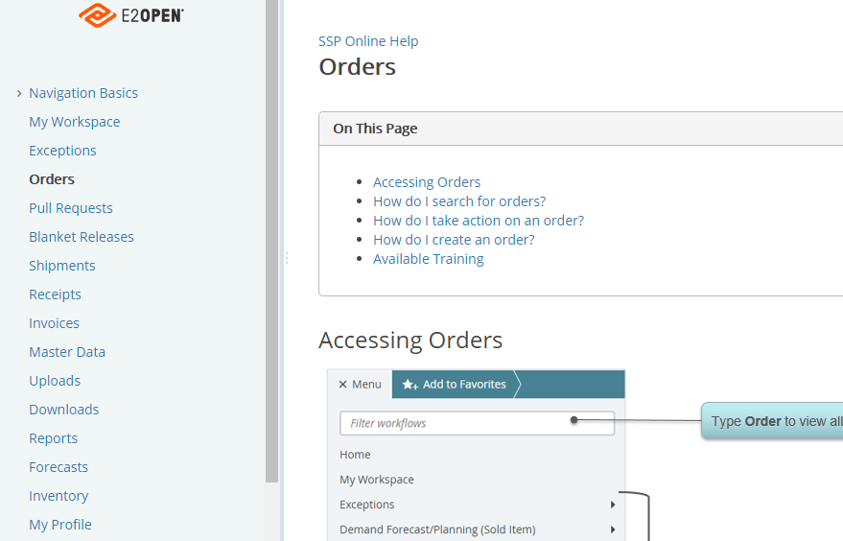
Getting Help
In the Header, click the Help icon.
Click a topic.
Click a subtopic.
  You may not have access to all the
  functionality shown in the Help files.
Help
Johnson Controls Inc.-INTERNAL-(Peter Daniel)
Notes:
You can always use the "Help" button to obtain more information or instructions on a specific topic or subtopic.

Slide 18
E2Open Password Reset

Slide 19
Reset Lost Password
In your browser Address box, type the URL for your system.
  https://johnsoncontrols.e2open.com
On the Login page, above the Password box, click Forgot.
Notes:
If for some reason you happen to forget your password you can always reset it yourself without having to contact anyone. On the login page, above the Password box, click the "Forgot" button and follow the instructions.

Slide 20
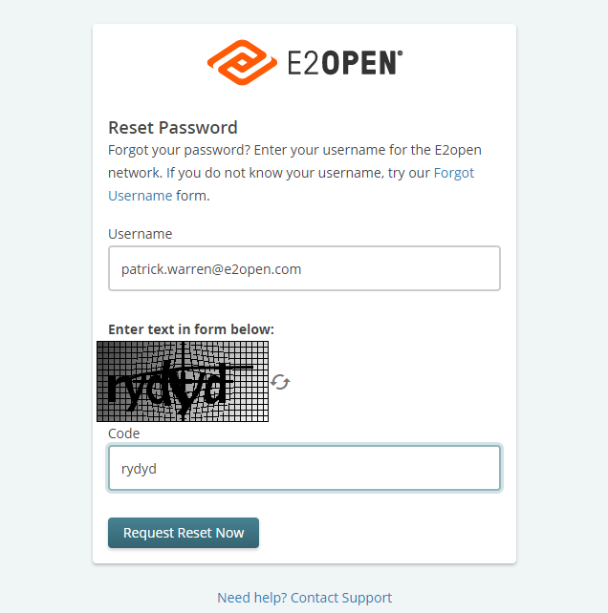
Reset Lost Password cont.
On the Reset Password page, in the Username box, type your username.
  Username is your email address in lower case.
In the Code box, type the security code.
  Click the Refresh icon if the security code is unreadable.
Click Request Reset Now.
Notes:
On the Reset page, type your "Username", which is your email address in lowercase. In the "Code" box type the security code listed & click the "Request Reset Now" button. Note: If the security code doesn't work, click the "Refresh" icon on the right side of the box to obtain a new code and retype the new code.

Slide 21
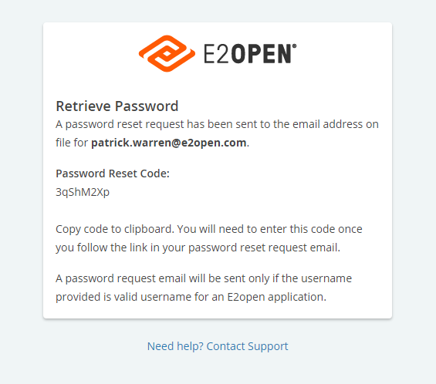
Reset Lost Password cont.
Take one of these actions to copy the password reset code.
  Select the code and press Ctrl+C (copy).
  Document the code in an easy to access location.
  Note: This is not a temporary password.
  The password reset code is required when entering your new password later
  in this procedure.
Notes:
You will receive a password reset code in your email that you will need to either copy & paste & use later or right the code down so you know it when requested later. Note: This is NOT a temporary password, but is required when entering your new password later in the process.

Slide 22
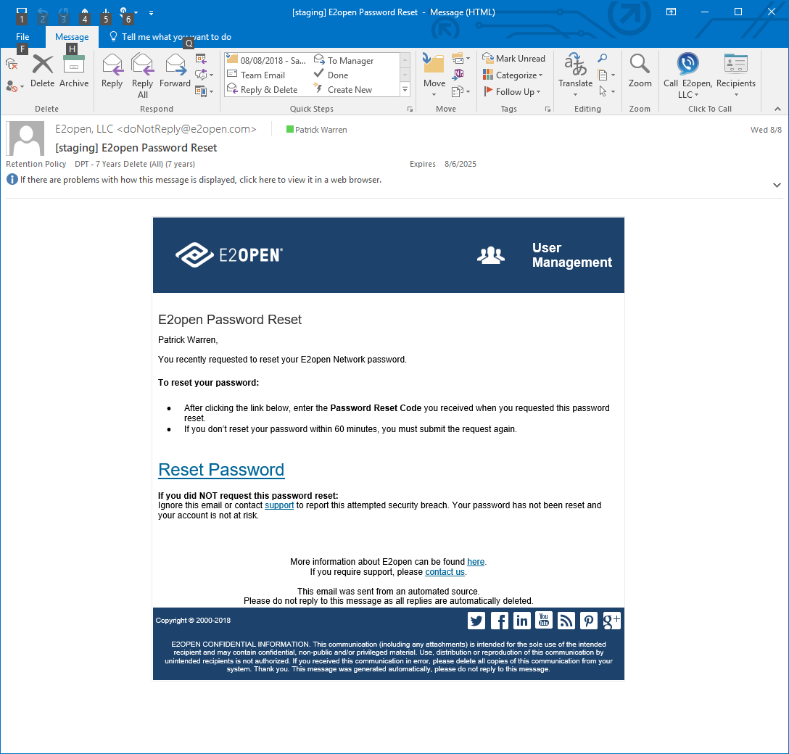
Reset Lost Password cont.
Access your email program, and open the E2open Password Reset email message.
  If you do not receive the email message within a few minutes, check your junk mail or spam folder. Contact your IT Department for any firewall blocks.
Click Reset Password.
  This launches the Reset Password page in your browser.
Notes:
This is a sample of the Password Reset email message you will receive. Click the Reset Password button.

Slide 23
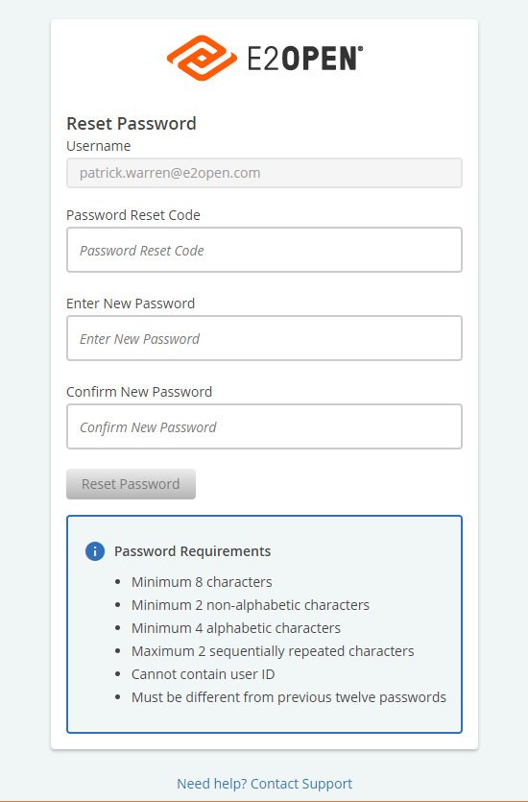
Reset Lost Password cont.
In the Password Reset Code box, take one of these actions to enter your password reset code.
  If you copied the password reset code, press Ctrl+V to paste it.
  If you saved the code in another document, then copy the code and paste it.
In the Enter New Password box, type your new password.
  Your password must meet password requirements.
In the Confirm New Password box, type your new password again.
Click Reset Password.
Notes:
Enter your Username (email address in lowercase). Enter the Password Reset Code from earlier in the box. Enter New Password, Confirm New Password, click the "Reset Password" button.

Slide 24
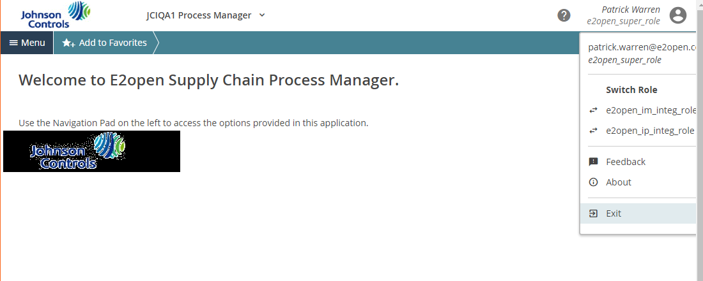
Reset Current Password
NOTE: Your password will need to be reset every 90 days for security. This is required. The reset password option is where you can reset your password at the 90 day mark or anytime before that. when a password reset is required the user will get a notification when they log into E2Open 5 days prior to the reset required date.
If you are not already in the system, log in to the system.
If you are not on the Launch pad page, take these actions.
  At the top right side of the page, click your username.
  Click Exit to return to the JCI Launch pad.
Notes:
Now this section allows you to change your password even if it's a valid one. Also, E2Open will instruct you to change your password every 90 days for security purposes. Follow the steps. If you are not already logged in the system, log in to E2Open. If you are not on the Launch Pad Page, at the top right side of the page, click your username. Click Exit to return to the JCI Launch Pad page.

Slide 25
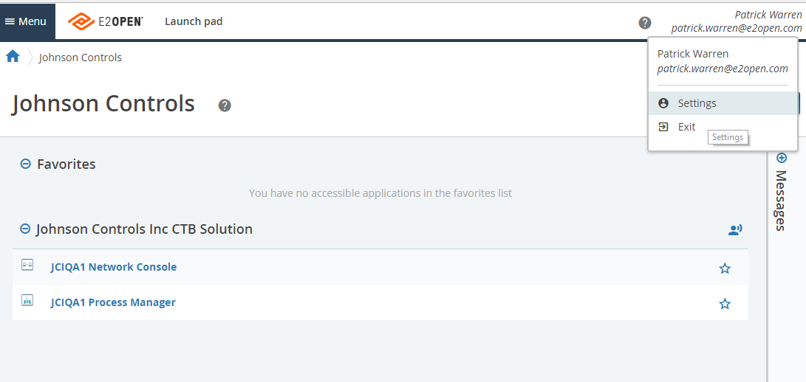
Reset Current Password
At the top right side of the Launch pad page, click your username.
Click Settings.
Notes:
At the top right side of the Launch Pad page, click your Username, Click Settings.

Slide 26
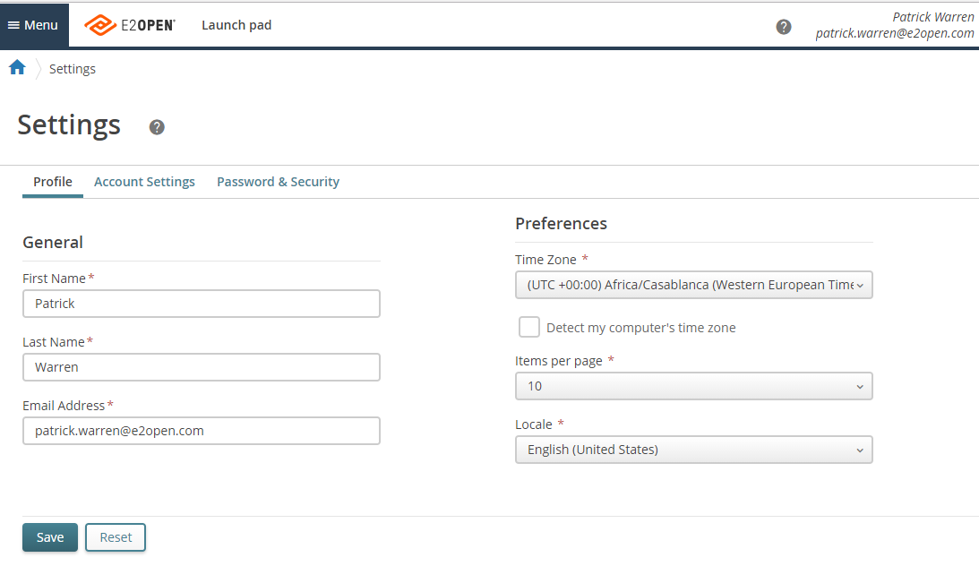
Reset Current Password cont.
Click the Password & Security tab.
Notes:
Click the Password & Security tab.

Slide 27
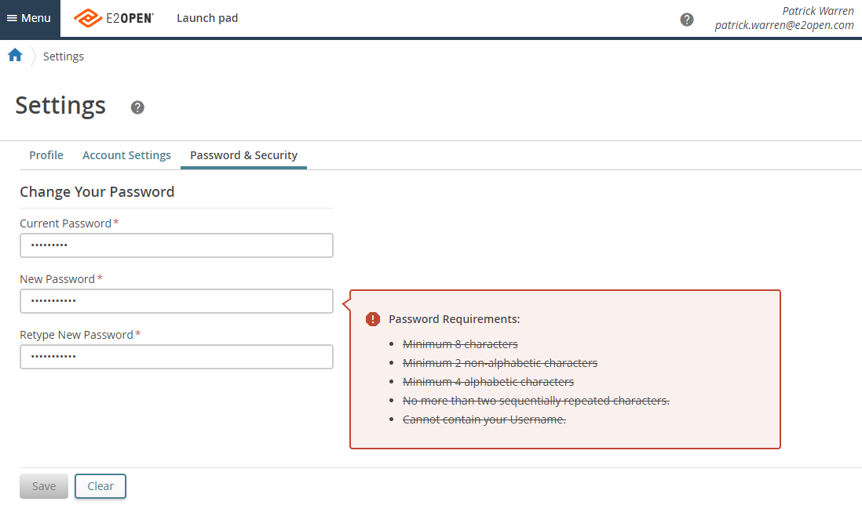
Reset Current Password cont.
In the Current Password box, type your current password.
In the New Password box, type your new password.
  Your password must meet password requirements.
Click Save.
Notes:
In the "Current Password" box type your current password. Then type your "New Password" in the new password box. Click Save.

Slide 28
Getting Support
Help desk support for both internal and partner users is typically provided by the organization that invited you to use the E2open solution. You can contact JCI through email at CG-e2open-ob@jci.com at any time this mailbox is monitored by the whole JCI onboarding team. This is our preferred method of contacting us
JCI is also available by calling into our Hypercare Hotline on Tuesdays, Thursdays & Fridays from 9:00am - 11:00am CST at 414-214-4100 Code 80685422.
Supplier Training will be held on Wednesdays from 9:00am - 11:00am CST at 414-214-4100 Code 80685422.
Johnson Controls Inc.-INTERNAL-(Peter Daniel)
Notes:
We ask that you communicate with us by using our email address shown, which is monitored by the entire Onboarding Team. We offer Hypercare Hotline calls on Tuesdays, Thursdays & Fridays at 9am-11am (CST) at the following phone # with Code. We also offer E2Open training on Wednesdays at the same time & same phone # & code.

