Slide 1
E2Open ASN Advance Ship Notice

Slide 2
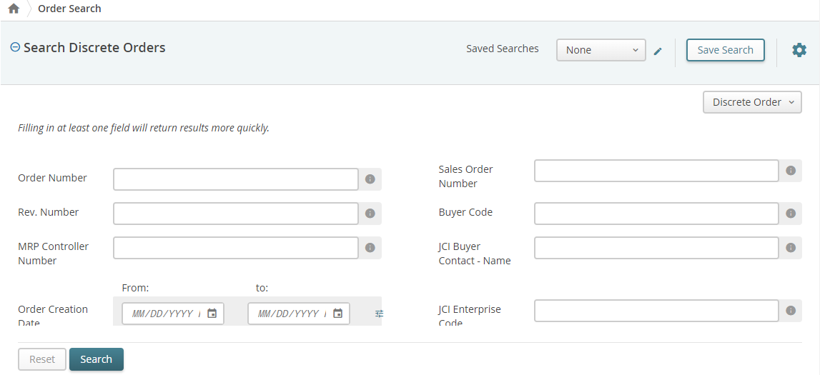
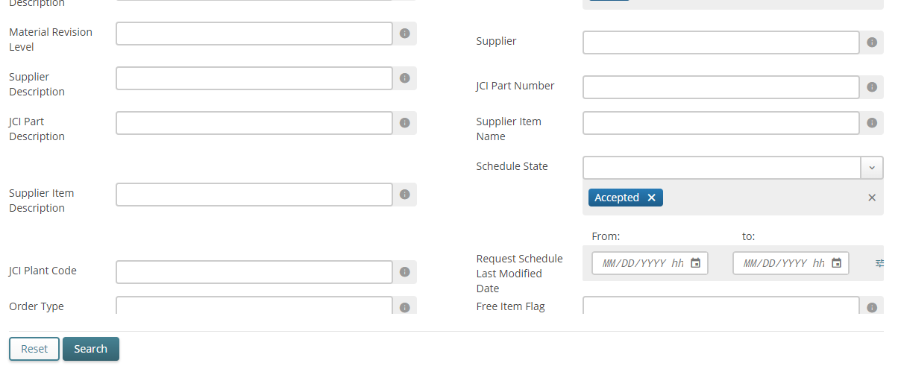
Creating an ASN
Click Menu, then click Collaborative Order Management, and then click Create Shipment.
Under the Shipment options.
Select Discrete Order from the drop-down.
For Schedule State, ensure only Accepted is selected.
Enter your search criteria.
Click Search.
Notes:
Trainer: (You should be toggling between the PowerPoint document & the E2Open tool) The ASN, which is an Advanced Ship Notice, is a Mandatory document that must be included with all shipments to the JCI Plant.
Read slide & demonstrate in E2Open.
If you are creating a shipment for SA Firm Deliver Schedule, select "Create Shipment" under the SA Firm Delivery Schedule Category. For Discrete orders, select "Create Shipment under the Shipment Category on the Collaborative Order Management page.

Slide 3
Creating an ASN
IMPORTANT NOTE: Verify the order selected is in the Accepted state before creating a ASN!
****ASNs should only be created when the order is in the Accepted state. ASNs created when the order is in any other state will be undefined in the system. This may affect supplier delivery performance and could cause processing delays. ****
6. Click the Order Number checkbox to select the order.
7. Click Next.
Notes:
Read entire slide

Slide 4
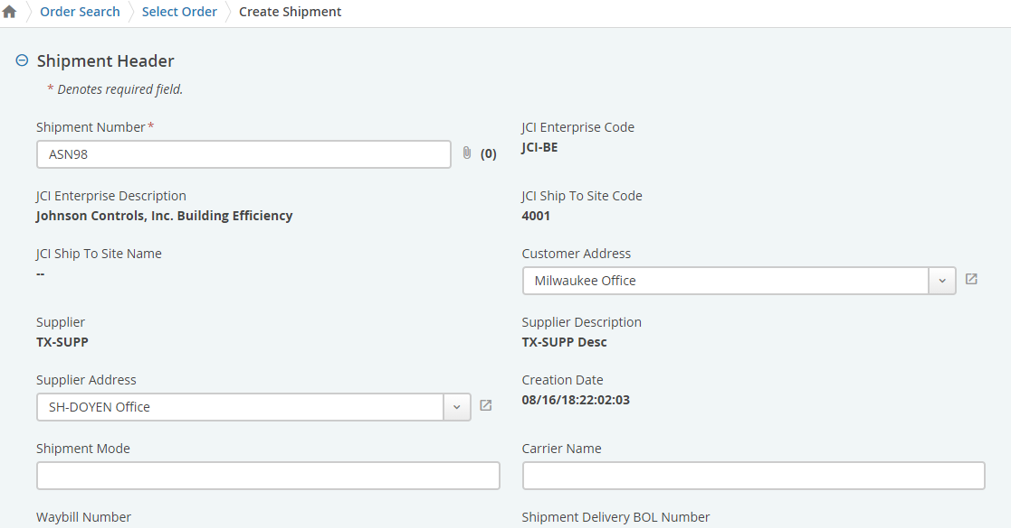
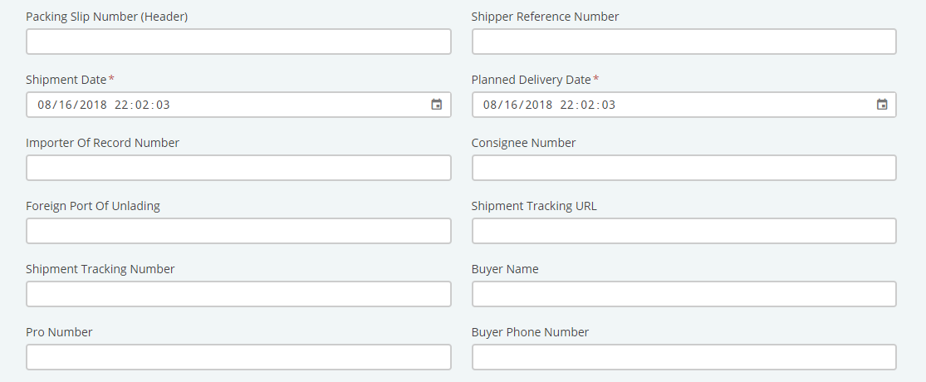
Creating an ASN
8. Enter the appropriate header data.
Fields that marked with (*) are Mandatory fields and cannot be left blank. Shipment # (ASN #), Shipment Date and Planned Delivery date
Shipment # (ASN # ) will default populate. We ask that you highlight and delete the populated default # and enter what you discussed with your supplier scheduler to determine what number you will put in here. This number can only be used once and cannot be duplicated. Many will use the Purchase Order # - Line item # - Release #.
Notes:
There are (3) Mandatory Fields on the Header section of the ASN & are marked with a RED asterik (*). The first is the actual ASN number, it will automatically populate with an ASN #. Be sure to communicate with your Supplier Scheduler what number they want you to use for your ASN # so you will need to delete the pre-populated ASN #. In training we use the PO # or the default ASN #. Note: This # can only be used once, so you can add a letter or dash for partial orders. The 2nd mandatory field is the Shipment Date, which is the date you are shipping the order. The third field is the Planned Delivery date and that is the day you expect the order to arrive at the JCI plant dock. Be sure to include transit time. FYI, if you have information for any of the other fields in the Header section, fill it in. The more information the better.

Slide 5
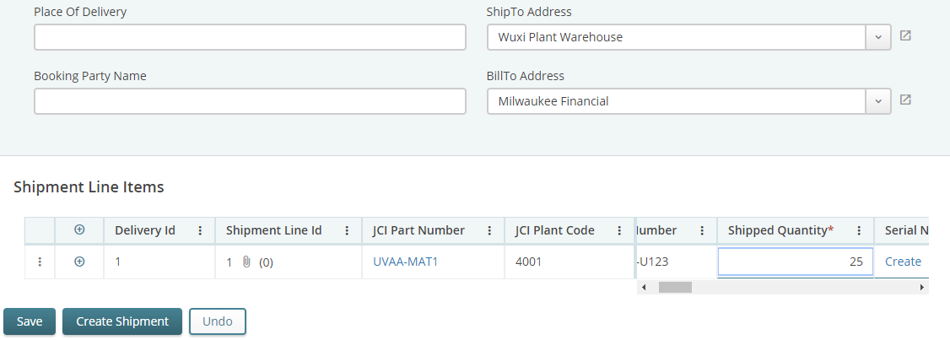
Creating an ASN
9. Enter the appropriate line item data, like Shipped Quantity.
If necessary, click the Details icon and edit any needed data.
Notes:
The bottom portion of the ASN is your Line Level and the two fields to complete will be the Weight in pounds & the # of boxes. The Quantity is defaulted and you can ship less, but never more than requested.

Slide 6
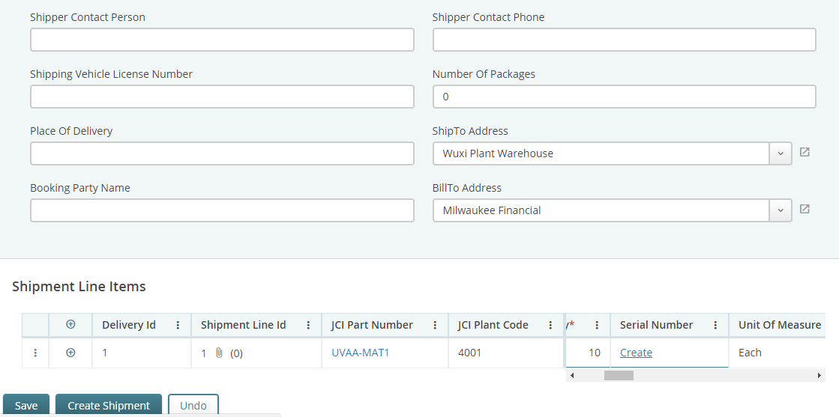
Creating an ASN
10. Optional actions before creating the ASN.
Click Undo to undo an entry.
Click Save to save a shipment to complete later (Draft ASN).
11. Click Create Shipment.
Notes:
When you're done completing the fields, click the "Create Shipment" button. If for some reason you realize you are not quite ready to ship this order, you can select SAVE and come back to this ASN when you are ready to ship the order. Trainer: (You should be demonstrate how to do a draft ASN afterward).

Slide 7
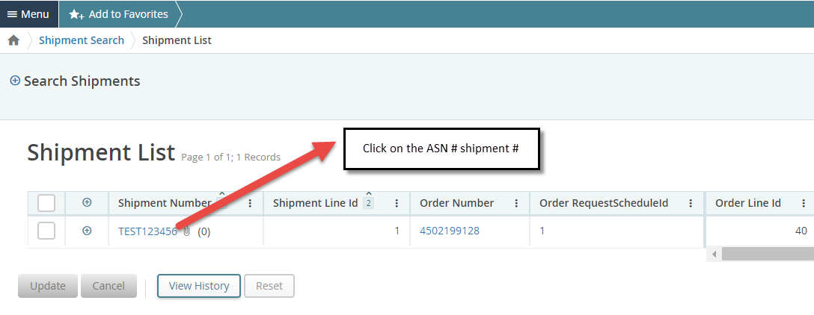
Creating an ASN
12. Clink on the hyper-link
13. Click on the ASN # Shipment #
Notes:
Once you've hit "Create Shipment", you get this flyout that says your Shipment # created successfully. Click the Hyperlink ASN #. On the Search Shipment Shipment List, select the ASN #.

Slide 8
Creating an ASN
11. Select the printer Icon in the upper right-hand side
12. Depending on you system setting you will see PDF file to open
Notes:
Click the Printer icon and you should get a PDF depending on your browser on how to receive it. It appears on the bottom left corner for us. Open the PDF file.

Slide 9
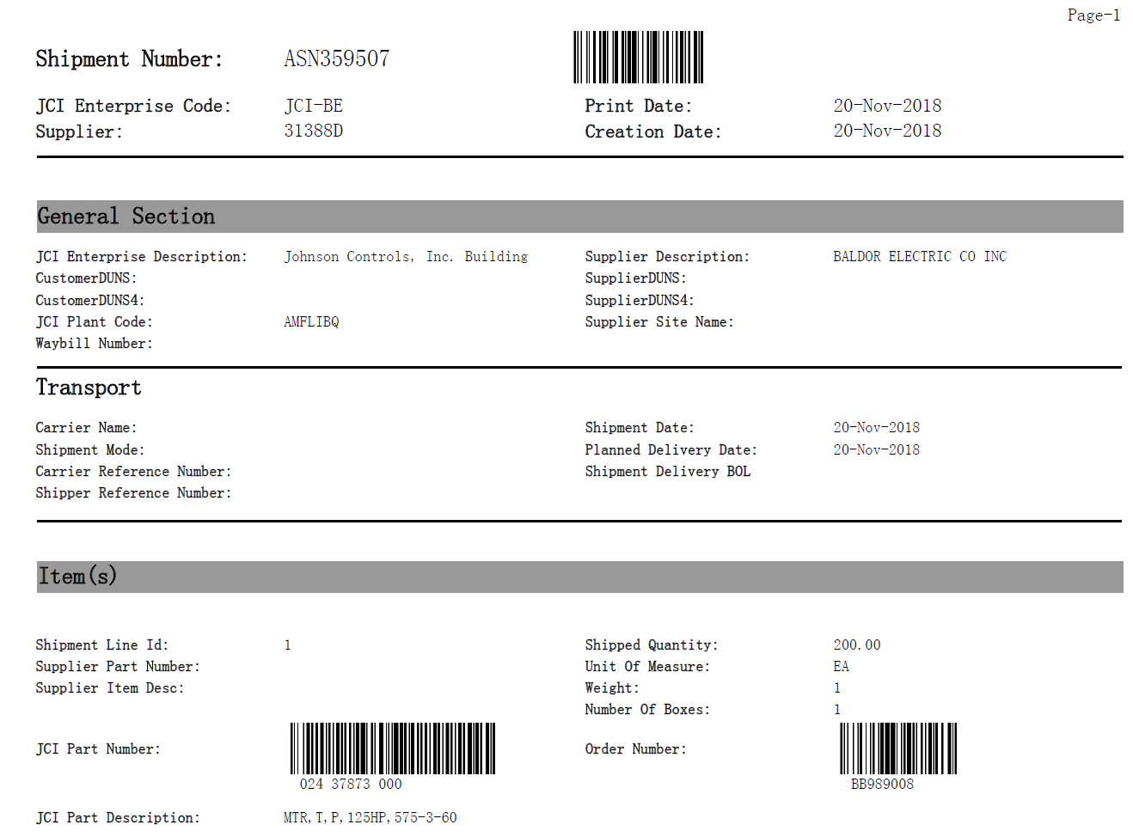
ASN PDF Sample
16. Print the ASN and attach to your shipment
Notes:
This is a Sample of the pdf document & what you should attach to your shipment. It has everything you entered about the order & includes the bar code, which JCI receiving department will scan in when they receive the order.

Slide 10
Publishing Draft Schedule ASN
1. Create portion of the ASN Shipment
2. Select the Save
3. You will receive dialog box stating you saved an ASN successfully
Notes:
This is what was mentioned above if you start an ASN & not quite ready to ship you can SAVE as a draft. It will say Draft shipment saved successfully.

Slide 11
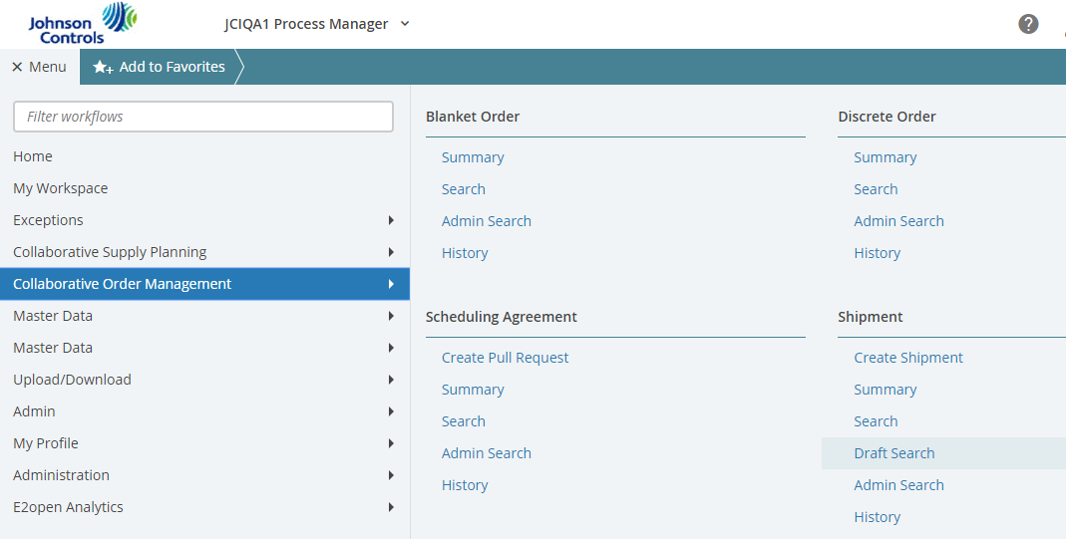
Publishing Draft ASN
Drafts ASNs have been started and saved but not yet created or published.
To finish creating and publishing a Draft ASN:
Click Menu, then click Collaborative Order Management and then click Draft Search.
Under the Shipment options group.
Notes:
How to find your Saved Draft ASN, you need to go to Collaborative Order Management & click under the Shipment Category, select Draft Search.

Slide 12
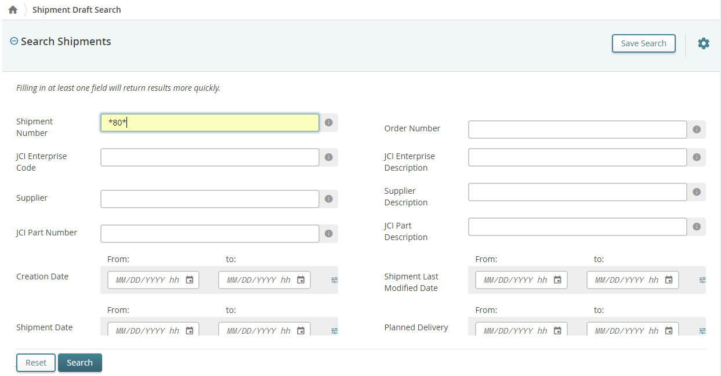
Publishing Draft ASN
Enter your search criteria. If you know the date or a portion of the number.
Click Search.
Notes:
Enter the Draft ASN # or whatever search criteria you know about the ASN you started, hit Search.

Slide 13
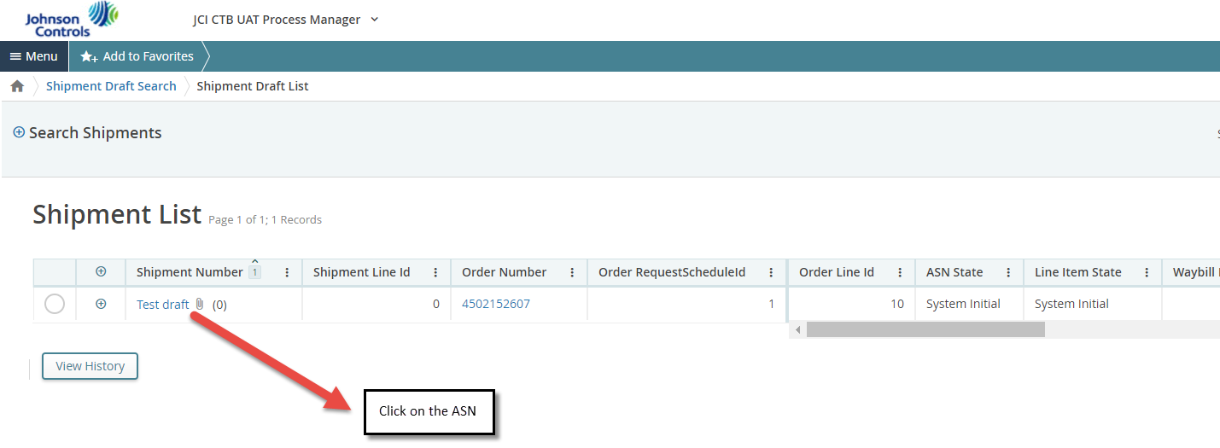
Publishing Draft ASN
4. Your search results will be displayed
5. Click on the ASN Shipment #
Notes:
Your search results will display, select the ASN # you want to finish.

Slide 14
Publishing Draft ASN
6. Click the Shipment Number to view the Details page.
7. Complete the ASN Shipment and click the Publish button.
8. You will receive dialog box your ASN Shipment was published successfully
Notes:
Click the ASN # to view the Details page. Complete the ASN information & click the "Publish" button. A dialog box will indicate the Shipment published successfully.

Slide 15
Publishing Draft ASN
9. Clink on the hyper-link
10. Click on the ASN # Shipment #
Notes:
Click on the ASN hyperlink #, select the ASN # on the Shipment List page.

Slide 16
Publishing Draft ASN
11. Select the printer Icon in the upper right-hand side
12. Depending on you system setting you will see PDF file to open
Notes:
Select the Printer icon on the top right to obtain the PDF file & open it.

Slide 17
Printing ASNs
Navigate to the Shipment Details page;
Click Menu, then Collaborative Order Management, then under Shipment section, through Search or Summary, navigate to Shipment List page.
Click on the ASN you wish to print (Under “Shipment Number” field)
Click the Print button, in the upper right corner.
What happens next is dependent on your browser and your settings. The file may be downloaded automatically, or you may see a dialog asking whether you want to save the file or open it with a specific application
Notes:
Print Icon top right

Slide 18
ASN PDF Sample
Print the ASN and attach to your shipment
Notes:
This is a Sample of the pdf document that includes the bar code for the JCI plant receiving department to scan it when the order comes in. This is mandatory to include with the shipment.

Slide 19
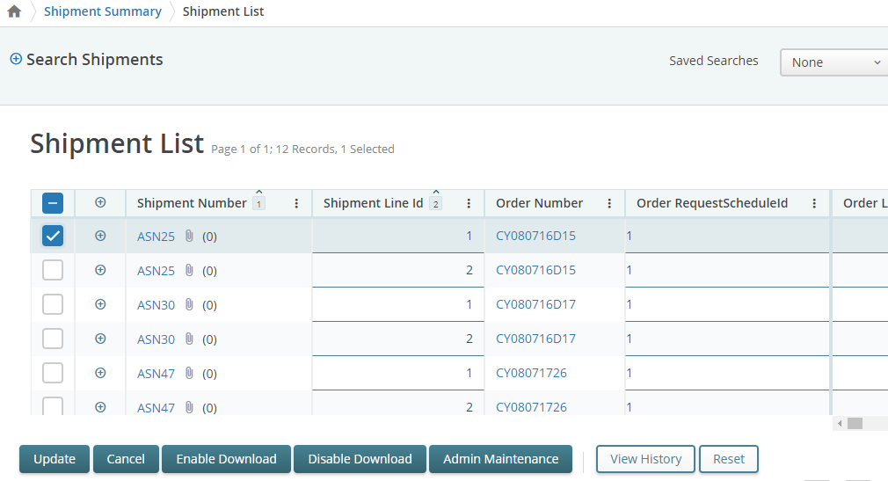
Editing and Canceling Shipments (Supplier)
Navigate to the Shipment List using Search or Summary.
Optional, click the Shipment Number to access the Details page.
Select the Shipment Number checkbox to select the desired item(s).
Make any edits necessary in the editable fields in the shipment line or header (see next slide for editable fields)
Click Update to incorporate any edits.
Any edits made are also
visible in the History for that
ASN
Click Cancel if you wish
to cancel the shipment line(s).
Note: You will not be able
to re-open any shipments that
have been cancelled. You will
have to create a new ASN for
that PO.
Notes:
Read slide

Slide 20
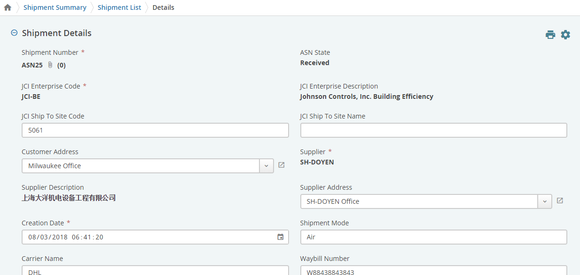
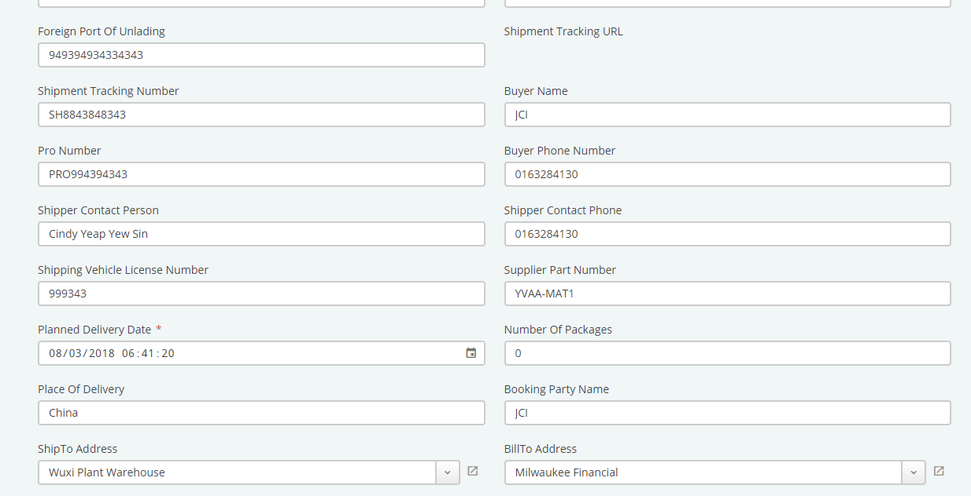
Editable ASN Fields
Fields supplier can update Shipment Lines in “Shipped” state:
Shipment Date
Planned Delivery Date
Shipment Quantity
Others
Editable fields in Header
Editable fields in Shipment List/Line level
Notes:
Read slide

Slide 21
E2Open Receipt

Slide 22
Receipts
JCI publishes the receipts to the system indicating the material receipt information.
Receipts created in JCI ERP system always refer to a valid shipment line.
Receipt are always created in Received state.
Johnson Controls Inc.-INTERNAL-(Peter Daniel)
Notes:
Read slide

Slide 23
Receipts
Creation of a receipt line in Received state triggers E2open to increment the total received quantity by the received quantity on the receipt line.
Referenced Discrete Order Request Schedule or Scheduling Agreement Delivery Schedule
JCI has the option to cancel an entire receipt or individual receipt lines in the Received state.
The system updates the associated order line’s total received quantity to reflect the receipt line’s received quantity..
Notes:
Read slide

Slide 24
Viewing a Receipt
From summary, search or History, click the receipt number to open the Details page
Notes:
Read slide

Slide 25
Supplier Visibility E2Open E-Learning Course Quiz
The following (14) questions are designed for you to review and answer to determine your level of understanding from the training you received & the PowerPoints themselves.
The supplier has the option of viewing the Purchase Order in PDF form while in the E2Open tool. (True or False)
2. On the My Workspace screen, select all that apply.
The screen is customizable.
The number represents how many items are in a specific state.
The five different boxes are called Cards.
It provides an overview of Exceptions.
All the above
3. E2Open is a cloud based tool that allows JCI Supplier Schedulers to transmit Purchase Orders electronically and suppliers will still be able to receive orders via fax or email.
(True or False)
4. The supplier will have the option to create the Advanced Ship Notice (ASN) and keep it on file at their location ONLY. (True or False)
The supplier will confirm and acknowledge only orders that are in the Accepted state.
(True or False)
6. Suppliers do not need to register into E2Open to access the tool. (True or False)
Notes:
The following (14) questions are designed for you to review and answer to determine your level of understanding from the training you received & the PowerPoints themselves.

Slide 26
Supplier Visibility E2Open E-Learning Course Quiz - Cont’d
The “EYE” icon has the function of allowing users to see what purchase orders are new in the system. (True or False)
What are the states of a Discrete Purchase Order? (Select all that apply)
New
Open
Accepted
Accepted with Changes
Cancelled
Closed
Waiting for Response
On Hold
9. The Mandatory Fields on the Header Section of an Advanced Ship Notice (ASN) are the, ASN #, Shipment Date, & Planned Delivery Date. (True or False)
10. In the training, does a Purchase Order need to be confirmed before a shipment (ASN) is created? (True or False)

Slide 27
Supplier Visibility E2Open E-Learning Course Quiz - Cont’d
11. The Paper Clip indicates the supplier can ship the order. (True or False)
12. When logging into the E2Open system, your “Username” should be your email address in lowercase. (True or False)
13. The Accepted with Changes state represents orders that suppliers made a change to & now the Supplier Scheduler needs to approve the changes made or reject them. (True or False)
14. There are different sections to a Purchase Order. (Select the correct one)
Header & Line Level
Header & Bottom section
Header & Print Level

Slide 28
Getting Support
Help desk support for both internal and partner users is typically provided by the organization that invited you to use the E2open solution. You can contact JCI through email at CG-e2open-ob@jci.com at any time this mailbox is monitored by the whole JCI onboarding team. This is our preferred method of contacting us
JCI is also available by calling into our Hypercare Hotline on Tuesdays, Thursdays & Fridays from 9:00am - 11:00am CST at 414-214-4100 Code 80685422.
Supplier Training will be held on Wednesdays from 9:00am - 11:00am CST at 414-214-4100 Code 80685422.
Johnson Controls Inc.-INTERNAL-(Peter Daniel)
Notes:
Talk through this whole slide

